Slide 1
Forum on Shared Governance
Tuesday, April 11, 2017 – 3:00 PM
The Budget Process: What is it and how can we make it better?

Slide 2
Current Budget Process
Vice-President Westman
  Process
    Participants
      Internal – Stakeholders defined
      External – OSRHE & RUSO
    Prioritization Guidlines

Slide 3
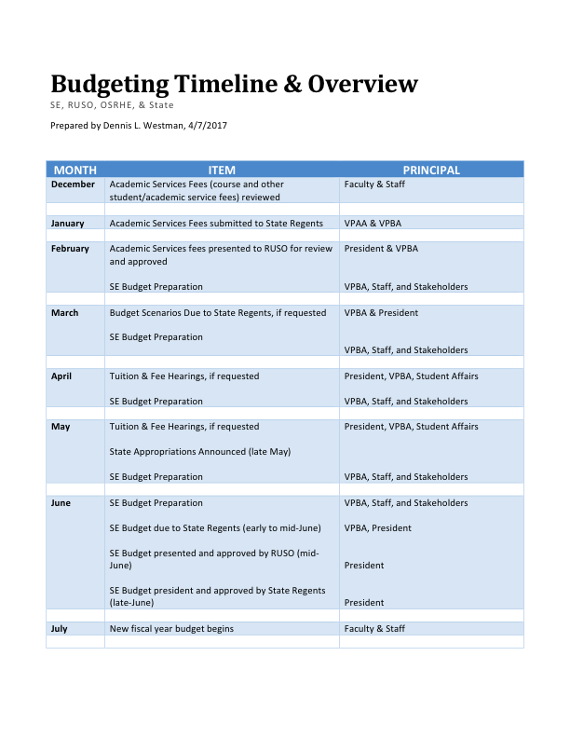

Slide 4
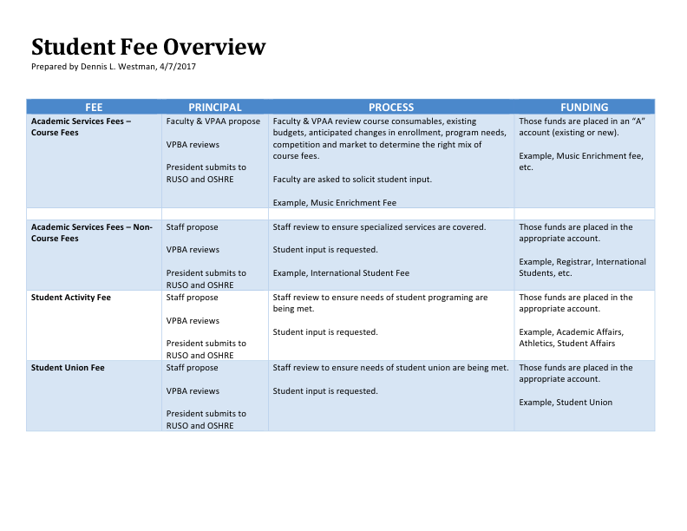

Slide 5
Current Academic Fees
Current Fees on
SE website
http://www.se.edu/future-students/freshman-estimated-cost/

Slide 6
All Fees Assessed
Proposed fees to RUSO for FY18
http://media.wix.com/ugd/f17c8f_c4713c099824491b81918c5ff9d90fc0.pdf
Current Fees - Excel

Slide 7
Questions - Fees
What is the timeline to access fees collected for specific purposes (i.e. lab fees, art supply fees, etc.)? When are they made available to the departments/faculty/staff?
What is the process currently used to make supply fees available?
Can fees assessed, but not used, be carried over from year to year to pay for big ticket items?

Slide 8
Open Discussion
Questions/Concerns
How can we improve?

