Slide 1
Enrollment-Recruiting Advisory Committee

Slide 2
Committee Members
Tristan Eggener, Chair
Kitty Campbell
Darin Grover
Wayne Jones
Bruce King
Matt Morris
Ross Sandmann
Claire Stubblefield

Slide 3
Committee Charge
Assess our current recruitment efforts in North Texas.
Utilize a consultant’s report to assist in analyzing such factors as demographics, out of state tuition waivers, scholarships, etc.
Should we increase our recruiting efforts in North Texas? If so, how?

Slide 4
Committee Charge cont’d
What are some specific ways to engage faculty in recruiting students for their respective departments?
Programs such as athletics, theatre, and music actively recruit, but how do we get all academic departments to buy into the concept?
What actions can we take to impact spring and fall 2016 enrollment?

Slide 5
Recommendation 1:
Utilize Faculty and Staff in Recruiting
1. Identify departmental point person to coordinate recruitment efforts.
2. Require each department to develop a specialized recruitment plan.
3. Require departments to provide annual updates on their recruitment efforts.
4. Hold a professional development session.
5. Break-out session for each department

Slide 6
Recommendation 1:
Utilize faculty and staff in recruiting
5. Require all departments to coordinate recruiting efforts with the Directors of Admissions and Recruitment* and University Marketing.
6. Continue to recruit at high schools, college fairs and key feeder schools.
7. Continue recruitment efforts on the SE campus, such as SE live, and Transfer Enrollment Day.

Slide 7
Rationale
Recruiting is vital for growth. Employing additional recruiters may not be an option, so faculty and staff taking on recruitment is a good option. By pulling everyone into the recruitment roles, SE will develop a culture of responsibility, accountability and ownership of recruitment efforts.

Slide 8
Recommendation 2:
Separate the Office of Admissions and Recruitment
1. Staff the Office of Admissions with three full-time admissions processors and the Office of Recruitment with three full-time recruiters .
2. Develop relationships with high school counselors by assigning recruiters to specific territories.
3. Require the Recruitment Office to develop and maintain a recruitment common calendar for the campus community to see events and scheduled personnel to attend.
4. Require Offices of Recruitment and Admissions to stay open five days during summer term (possibly by flexing employees’ schedules if we continue the 4-day week).

Slide 9
Recommendation 2:
Separate the Office of Admissions and Recruitment
5. Follow-up with each potential student who contacts SE for information. Send hardcopy informational brochures, such as the view book, as well as emails, and monitor response rate.
6. Follow-up with every student who applies (or is admitted) with phone calls throughout the process by an admissions staff member or by student workers.
7. Invite students who have applied to schedule a campus tour, meet with an advisor, etc.

Slide 10
Recommendation 2:
Separate the Office of Admissions and Recruitment
10. Purchase ACT contact information
Composite score of 19-24 and send mail outs to prospective students and their parents
Purchase contact information from ACT for students who have scored 25 and above.
11. Give out athletic tickets/t-shirts by drawing names or numbers when recruiters are speaking to groups of students.

Slide 11
Recommendation 2:
Separate the Office of Admissions and Recruitment
8. Create a campus-wide database of prospective students.
Accessible to faculty and staff with ability to add to the database.
Could be fed by an online questionnaire for prospective students.
9. Emphasize that recruiters and other university personnel should wear Southeastern apparel when recruiting.

Slide 12
Rationale
Separating the Office of Admissions and Recruitment would allow recruiters and admissions staff to focus on the specific requirements of their unique responsibilities.
Moreover, focusing recruitment efforts will permit resources to be used more efficiently.

Slide 13
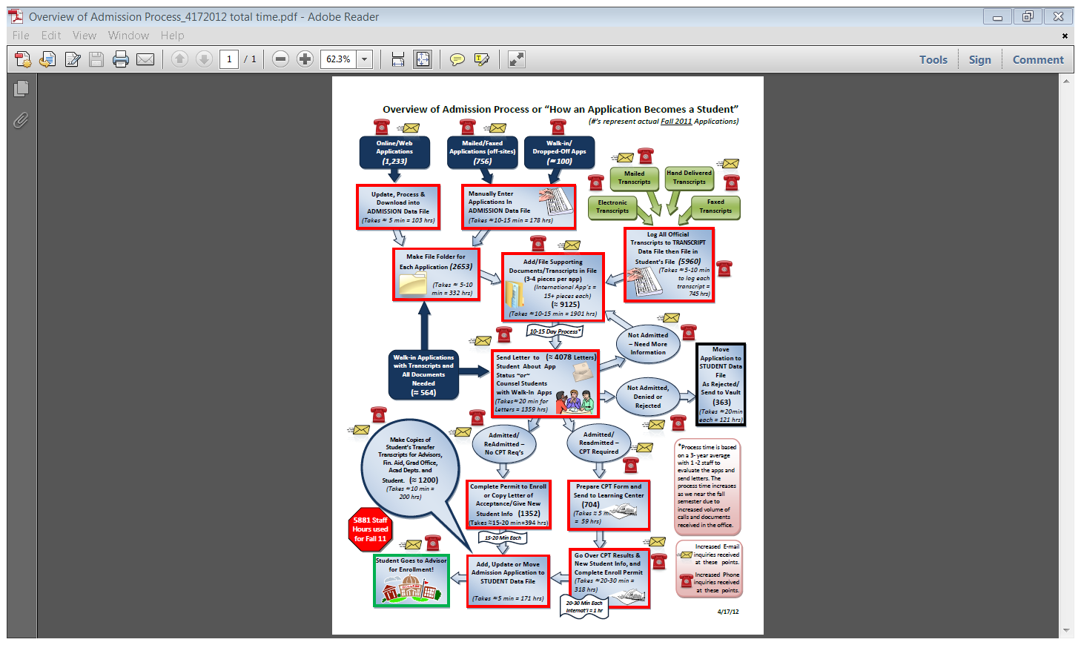

Slide 14
Recommendation 3:
Shift institutional culture to students first.
1. Devote extra attention to front line offices such as financial aid, resident life, and business offices since they serve students when initially considering SE.
2. Implement a “Secret Shopper” type of system to get a feeling for how students first experience SE. Use findings in future decision-making processes.
3. Send students a “welcome packet” once they have been admitted.

Slide 15
Rationale
Improving customer service will allow the university to attract and retain students.
The best recruiting tool is a positive experience that is shared with friends and family.

Slide 16
Recommendation 4:
Maximize the impact of current tuition and fee structure
1. Make tuition and fee information readily accessible and easy to understand.
2. Maintain existing non-resident fee waiver structure.
3. Based on the market analysis report (Maguire, 2015), consider marketing our cost of attendance to parents of students living in North Texas in relation to in-state Texas institutions.
4. Consider tuition incentives for veterans.

Slide 17
Rationale
Based upon market analysis report (Maguire, 2015) we are at a competitive advantage with Texas institutions and comparable with Oklahoma peer institutions.

Slide 18
Recommendation 5:
Focus recruitment initiatives to growth areas and instructional delivery methods.
1. Continue to focus recruitment efforts in North Texas.
2. Consider future student markets in heavily populated areas.
3. Explore expanding programs at outreach locations.
4. Create the infrastructure to market programs that are experiencing exponential growth i.e. online programs.
5. Explore offering more courses in 8 week blocks, hybrids, minimesters, and evening formats.

Slide 19


Slide 20
Rationale
Southeastern Oklahoma State University’s close proximity to North Texas and the growing Dallas/Fort Worth Metroplex makes recruitment in these areas a priority.

Slide 21
Recommendation 6:
Use a multi-channel campaign for recruiting
1. Create a START HERE button on the SE homepage that includes direct links to the online application, residence life application, scholarships, etc.

Slide 22
Recommendation 6
Use a multi-channel campaign for recruiting
2. Make it easy for prospective students, especially non-traditionals; to find the information they are looking for on the website. Establish a landing page for adult learners that:
Shows them what programs of interest are available
Walks them through the application process in quick, easy steps
Includes only the information they most need and how to request more information
Informs them of what financial aid is available and how to complete an application
Includes video testimonials from other adult learners describing what their experience has been like at SE.

Slide 23
Recommendation 6
Use a multi-channel campaign for recruiting
3. Allow students to tour campus through an interactive video game.
4. Feature student blogs on the website.
5. Offer Podcasts featuring faculty members and undergraduates that show what the university has to offer.
6. Offer live chat sessions for perspective students to learn more about the campus and admissions process.
7. Use social media to post reminders, news, and application deadlines.

Slide 24
Recommendation 6:
Use a multi-channel campaign for recruiting
8. Virtual college fairs
9. One-on-one Skyping
10. Highlight alumni on social media
11. Create a mobile app
12. Include QR codes on all recruiting publications

Slide 25
Rationale
Students, traditional and non-traditional, respond to varying forms of marketing and advertising.

Slide 26
Recommendation 7:
Actively recruit veterans
1. Recruit on military bases
2. Establish a veteran advisory group to bring together multiple departments in collaborative efforts to enhance and develop veteran services.
3. Establish a student veteran organization.
4. Provide assistance for veterans in their transition from military service to higher education.

Slide 27
Rationale
Veterans are growing future student population, and SE needs to position programming to respond to their interests, schedules, and needs.

Slide 28
References
Maguire Associates. (2015). Southeastern Oklahoma State University Competitor Assessment. Concord, MA: Maguire Associates, Inc.

