Slide 1
President’s Budget Advisory Committee
Findings and Recommendations

Slide 2
Priority
To increase enrollment in the future, students must have quality at a price they afford. Quality requires full time faculty teaching face-to-face and meaningful extracurricular activities on the Durant Campus.

Slide 3
Charge
Current Year, FY 2016: $1,200,000 reduction
State appropriations:
FY2016 $18,844,628
FY2016 3.5% reduction = $659,562.
FY2016 $18,185,066 – 3% = $545,552
FY2016 $18,185,066 – 5% = $909,253
FY2016 $18,185,066 – 7% = $1,272,955
FY2016 $18,185,066 – 10% = $1,818,506
Max New Revenue from tuition & Fees: $1,129,200
Subtract Mandatory Costs: 1% increase or $465,000

Slide 4
Cash Flow
Negative
Chris Moretti

Slide 5
Cash Flow
-741,685

Slide 6
Priority: Students
Faculty 130
Admin 34
Staff 157
Coach 19
Librarian 5
23.4%
$10,650,289
75.6%
$ 37,567,288

Slide 7
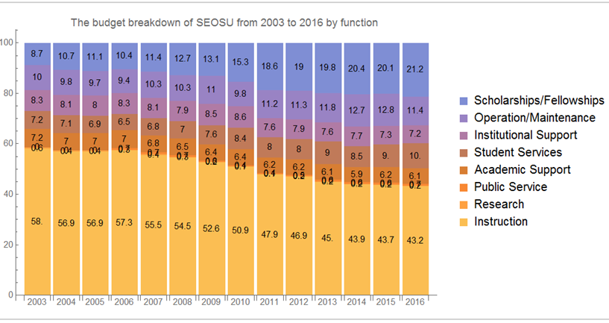
Scholarships/Fellowships

Slide 8
Process Recommendations
Evaluate and Improve Institutional Effectiveness using consistent data collection, analysis, and
benchmarks
Utilize an Annual Budget Review and Proposals Process
Align the distribution and replacement of faculty with university priorities, institutional
effectiveness and shared governance procedures
Create an Annual Capital Campaign
Reduce dependency on cash fee waivers
Develop a standard for creating summer school schedules
Improve energy efficiency through course scheduling and weatherization
Ask each unit to provide possible cost savings proposals of 10%

Slide 9
Annualized Reductions
Vacancies:
Professional
Outreach
Support
Operational
Faculty Reassign Time
Restructure
$653,329
$643,815
$543,658
$ 69,409
$134,006
$ 69,440
$160,613
Approximately $2,391,503

Slide 10
“Quality at a price you can afford.”
Structural Deficit: = $ 741,685
FY2015-16 $18,185,066 – 10% = $1,818,506
Proposals Approximately = $2,391,503
The Budget Advisory Committee has prioritized the experience on the Durant campus both in academic and extra-curricular experiences.

