Slide 1
Faculty Compensation:
It’s the right thing to do!
Shared Governance Forum
November 10, 2020

Slide 2
Key issues:
The university is spending too little on instructional salaries
The real salaries of tenured professors have been going down
Faculty pay is not equitable

Slide 3
University mission = educate students
Percentage of overall budget spent on instructional salaries:
1993: $13,130,863 41.1% of university budget
2020: $10,509,237 21.8% of cash budget
18.1% of raw budget
The budget percentage spent by the university on instructional salaries is HALF of what it was 27 years ago!

Slide 4
Buying power of our salaries:
Assistant Professors:
1993: $62,091 2020: $67,542 + $5451
Associate Professors:
1993: $76,074 2020: $69,639 - $6435
Full Professors:
1993: $83,464 2020: $77,694 - $5770

Slide 5
Salary compression and
the devaluation of experience
Our salary structure causes us to lose good faculty:
Examples: Alistair Maeer and Blythe Duell
Both tenured associate professors
Both winners of Faculty Senate’s Professor of the Year award
Both left for untenured positions at a lower rank
Both received significantly higher pay at their new institutions
Our faculty can make more in entry-level positions at other universities
than they do as tenured associate professors here

Slide 6
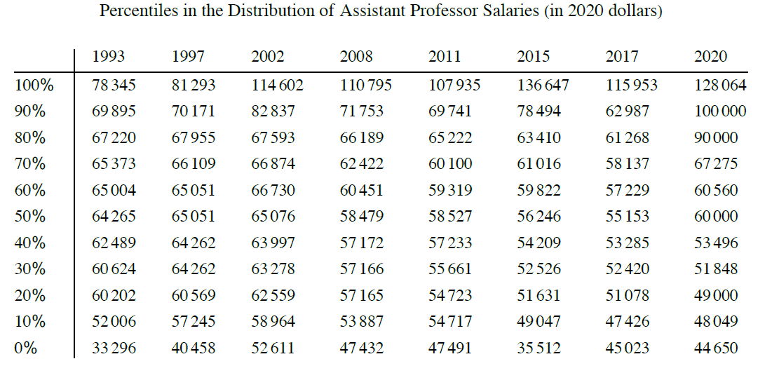
Assistant Professor Salaries:
On-card, Assistant Professor
3 years in (i.e. average):
No prior experience: $48,049
5+ years prior experience: $49, 414
(elsewhere)
Current mean: $67, 542
Current median: $60,000

Slide 7
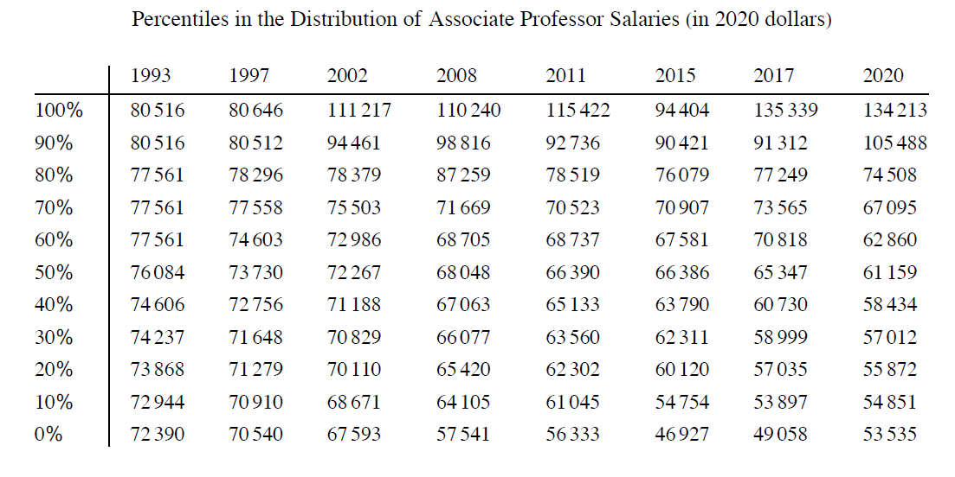
Associate Professor Salaries:
On-card, Associate Professor
8 years in (3 years at rank):
No prior experience: $53,815
5+ years prior experience: $55, 180
(elsewhere)
Current mean: $69,639
Current median: $61,159

Slide 8
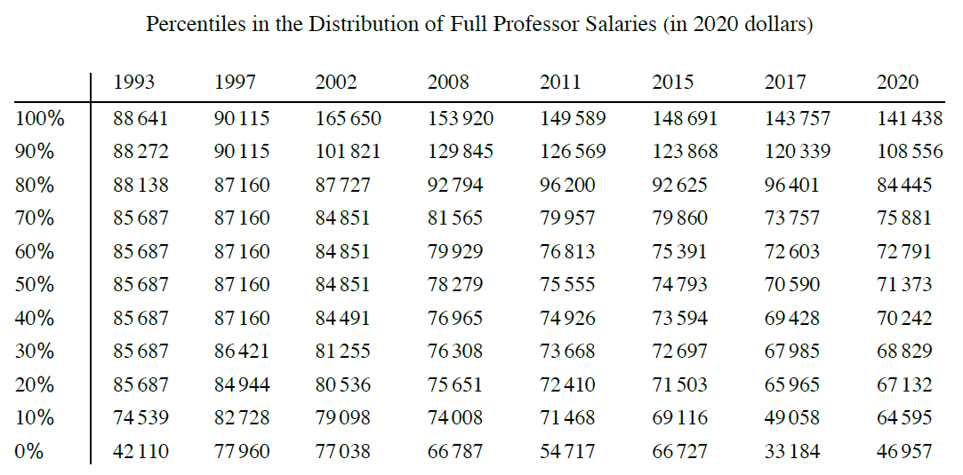
Full Professor salaries:
On-card, Full Professor:
15 years in: $62,317
5+ years prior experience: $63,682
(elsewhere)
Salary cap (31 years): $71,053
Current mean: $77,694
Current median: $71,373

Slide 9
Key take-aways:
The university is spending too little on instructional salaries
The university should dedicate a larger portion of its budget to faculty salaries
The real salaries of tenured professors have been going down
Annual raises must at a minimum keep up with inflation, and ideally provide an incentive for our experienced professors to stay
Faculty pay is not equitable
The salary card needs to be updated so that it is a realistic representation of most salaries, or a different compensation system must be developed. The current system does not work.

