Slide 1
Anthology
Best Practices and Q&A

Slide 2
Definitions
Anthology-Third-party platform for course evaluations. Formerly Campus Labs.
IDEA Diagnostic Feedback Instrument-Survey instrument used to collect responses from students at the end of the semester regarding their courses. Also referred to as survey and evaluation.
Course-The course as a whole, including all sections (ex. ACCT 2103).
Section-An individual section of a course (ex. ACCT 2103.W1).
Administration-Group of sections to be evaluated. Can have multiple administrations in a semester.

Slide 3
IDEA Diagnostic Feedback Instrument
4 core sections, 41 questions:
The Instructor-19 questions
Progress On Relevant Learning Objectives-13 questions
The Course-8 questions
Open-Ended Comment Section
Custom questions:
All students-4 questions
Online courses only-12 questions

Slide 4
Objective Selection Forms
13 learning objectives (outcomes) to choose from
Recommended 3-5 total Essential and/or Important
Must complete each semester for all sections
Can be auto filled and “locked down”

Slide 5
Response Rates
Monitor response rates
Set aside class time
Incentives
Extra credit
Personalized email
Course requirement
Share evaluation results
Compiled directly from Anthology’s website

Slide 6
Report Thresholds
Enrollment | Reponses | Instructor Receives Report
1-3 students | Less than 100% | No
1-3 students | 100% response rate | Yes
More than 3 students | Less than 3 students | No
More than 3 students | 3 or more respondents | Yes
Compiled directly from Anthology’s website

Slide 7
Faculty Reports and Data Comparison
Summary-Compares all sections evaluated for the semester
Summative-section specific
Adjusted Averages or Raw Averages
IDEA Database, IDEA Discipline, or Institution
Formative-provides recommendations on teaching methods and styles
Quantitative
Qualitative
Segment Comparison-compare results to institution, school, or department.
Trends Analysis-compare results over time for each section

Slide 9
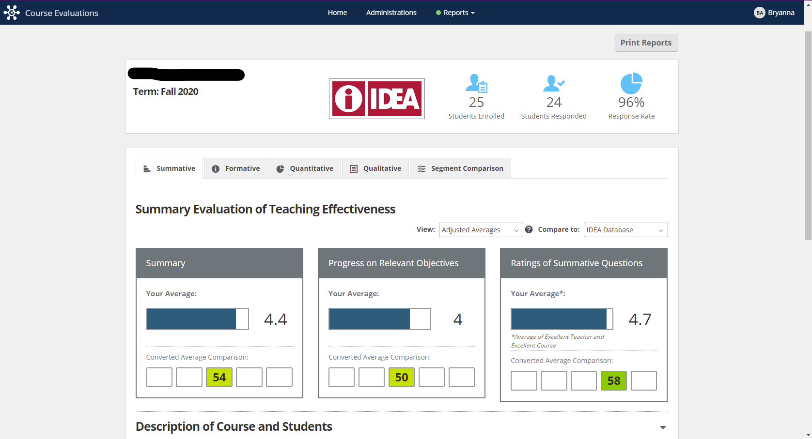

Slide 10
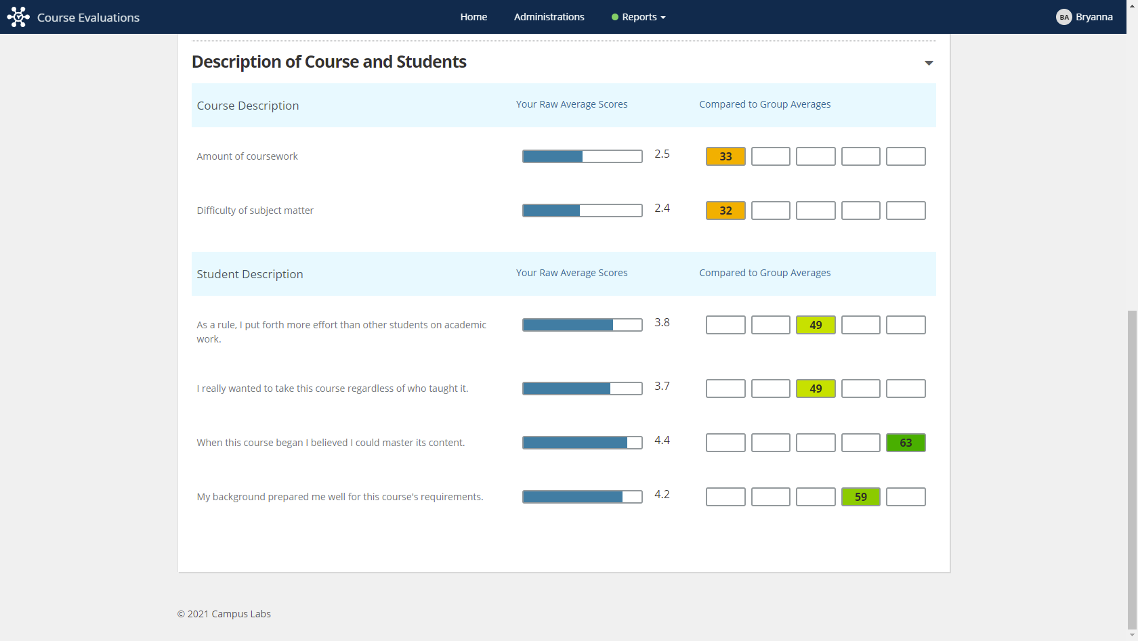

Slide 11
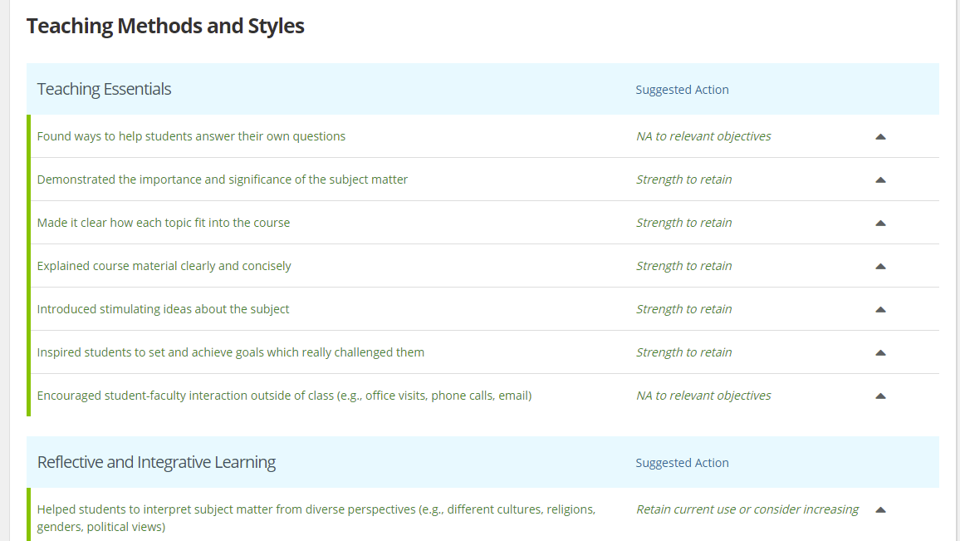
Formative Report

Slide 12
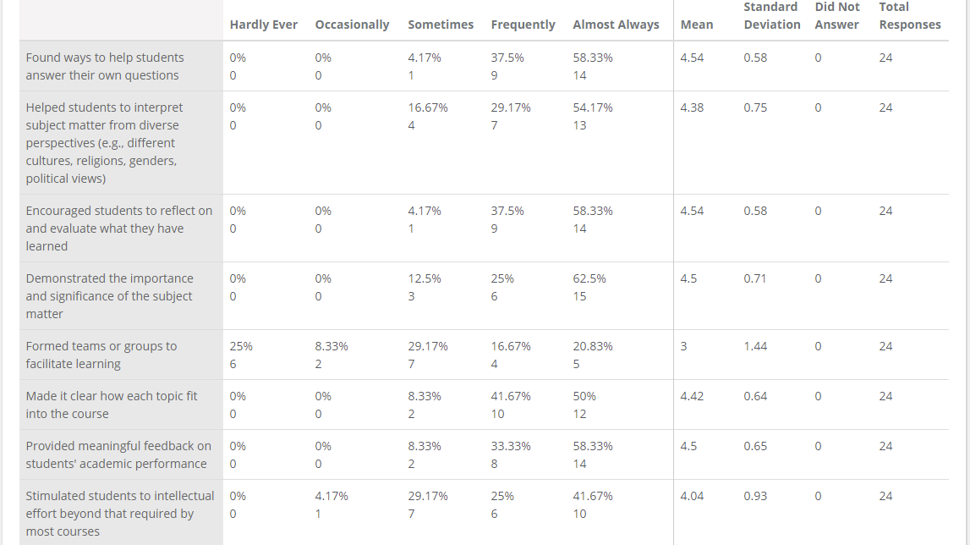
Quantitative Report

Slide 13
