Slide 1
Shared Governance Forum
March 28, 2022
Strategic Planning
Looking to the Future

Slide 2
Strategic Plan Framework
Purpose = Vision meets Strategy meets Tactical
Mission/Vision/Purpose
Strategic Plan Framework
Plan to Strategic Plan

Slide 4
Strategic Planning Assumptions
The impact of the pandemic is still not fully understood and it could be lasting
Our university is different today than it was two years ago.
We do not anticipate a significant shift in state funding support.
Future student populations, demographics, and perceptions have and will continue to change.

Slide 5
University Mission –
Southeastern Oklahoma State University provides an environment of academic excellence that enables students to reach their highest potential. By having personal access to excellent teaching, challenging academic programs, and extracurricular experiences, students will develop skills and habits that promote values for career preparation, responsible citizenship, and lifelong learning.

Slide 6
Our Values –
What do we value? This is generally three or four words with a single sentence descriptor.
EXAMPLE
Success
“We look beyond the present to value the future”
Our Purpose –
A simple sentence or statement
EXAMPLE
“Changing Lives, one student at a time”

Slide 7
Strategic Planning Framework
Goal I – Academic Excellence
Goal II – Affordability
Goal III – Sustainability
Goal IV - Facilities and Infrastructure
Goal V – Student Ready

Slide 8
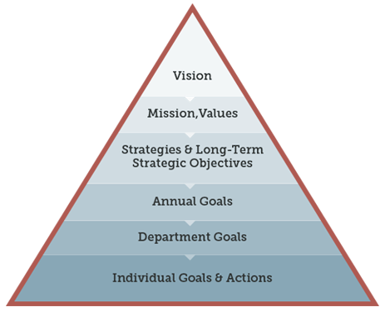

Slide 9
Strategic Planning Process
Identify Strategic Framework Complete
Appoint Campus Wide Planning Committee April 2022
Planning Committee Work April 2022-July 2022
Planning Committee Work Product to EC August 2022
Strategic Plan Finalization August 2022
Plan Presented to Campus September 2022
Departmental Planning Process September 2022-December 2022
Integration of Departmental Plans April 2023

