Slide 1
Shared Governance Forum 10-8-24
Dr. Thomas W. Newsom, President

Slide 2
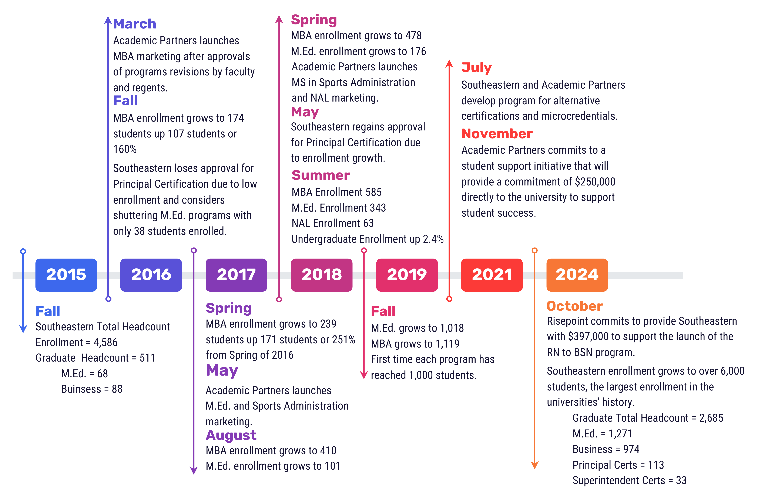
Growth Timeline

Slide 6
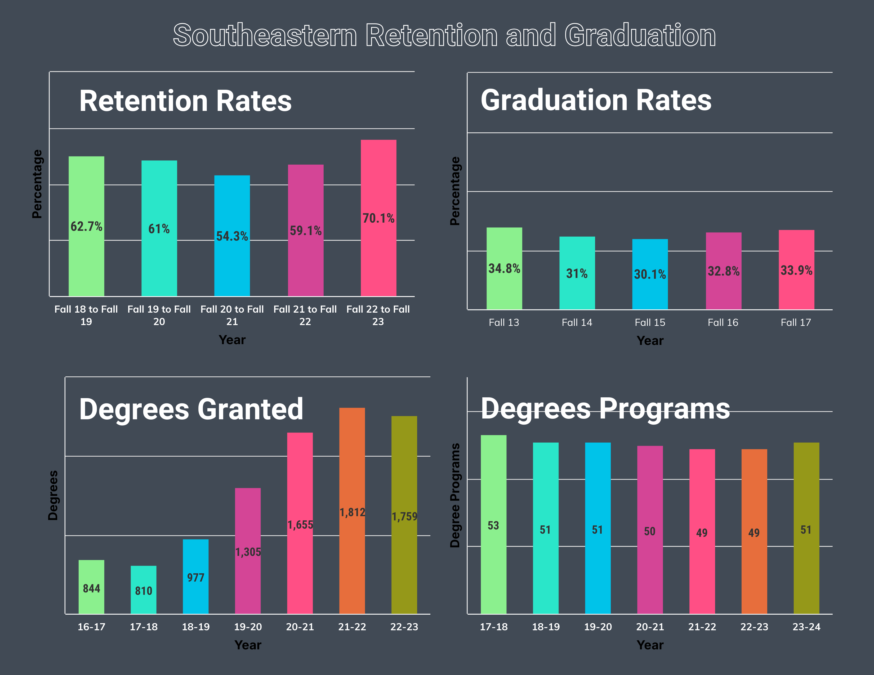

Slide 7
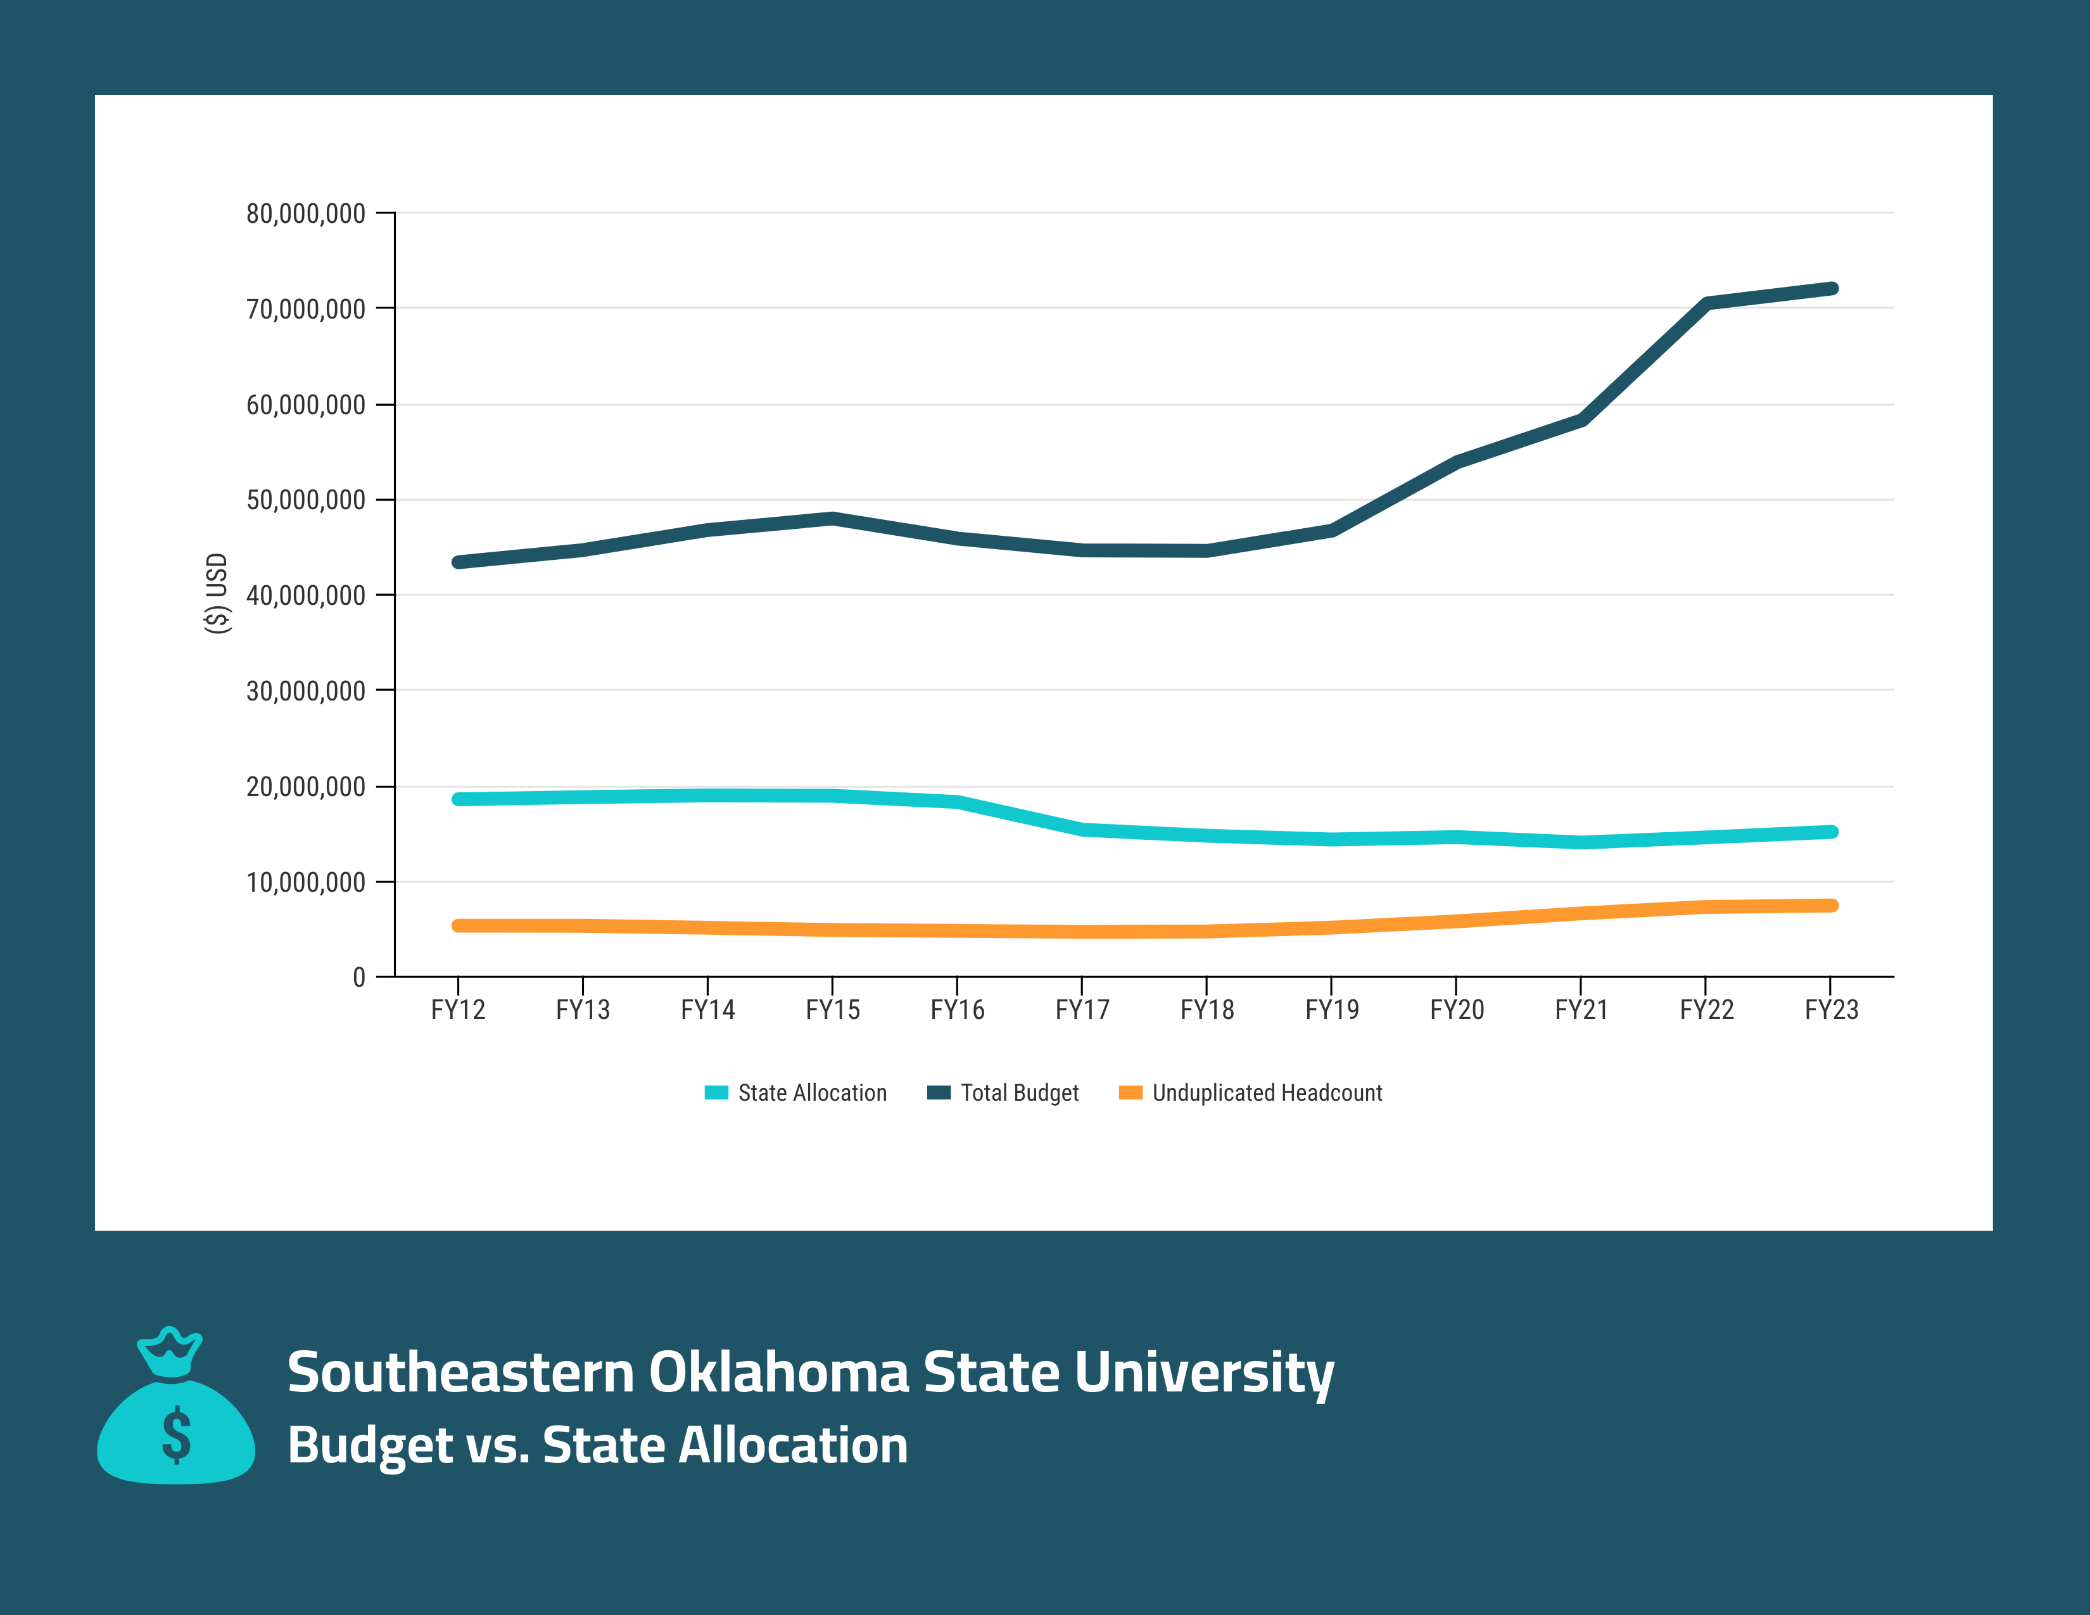

Slide 9
9/2020 – Growth Taskforce
Increase out of State Scholarships
Create Opportunities for Faculty to Assist in the Recruiting Process
Increase Opportunities for Specific Scholarship Programs
to Collaborate
Create Specific Space for
Specific Scholarship Programs
Ensure Campus Climate and
Culture is Welcoming to a Diverse
Population
Campus Facility Improvements
Increase Scholarships
Increase Capacity of Infrastructure and Faculty and Staff to Support Growth
“a shared goal to increase the number of total
undergraduate students on campus”
Academic Excellence and Leadership
Arts and Music
Athletics
Minority Student Recruitment and Retention

Slide 10
Ad Hoc Committee
Enrollment Growth, Student Retention and Capacity
Charge: An ad hoc committee on the continued enrollment growth of the university formed to address the issues related to growth and university sustainability and capacity.
The ad hoc committee will be made up of the following:*
4 Faculty Members – Recommended by Faculty Senate
4 Staff Members – Recommended by Staff Senate
2 – Student Members – Recommended by Student Government Association
2 Administrative Members – Appointed by President
*Recommendation for membership will be made to the President. President reserves the right to accept or reject recommendations as well as modify committee structure as he deems appropriate.
Potential Outcomes
Strategies to address challenges of enrollment growth.
Relationship between enrollment growth and long-term sustainability.
Triggers to ensure capacity needs of infrastructure, faculty and staff to support ongoing growth.
Identify measurements of success.
Identify ongoing monitoring needs.
Identify how the Vision 2040 Strategic Plan informs growth.

Slide 11
Shared Governance Forum 10-8-24
Dr. Thomas W. Newsom, President

