Slide 1
RUSO Affordability and Plan

Slide 2
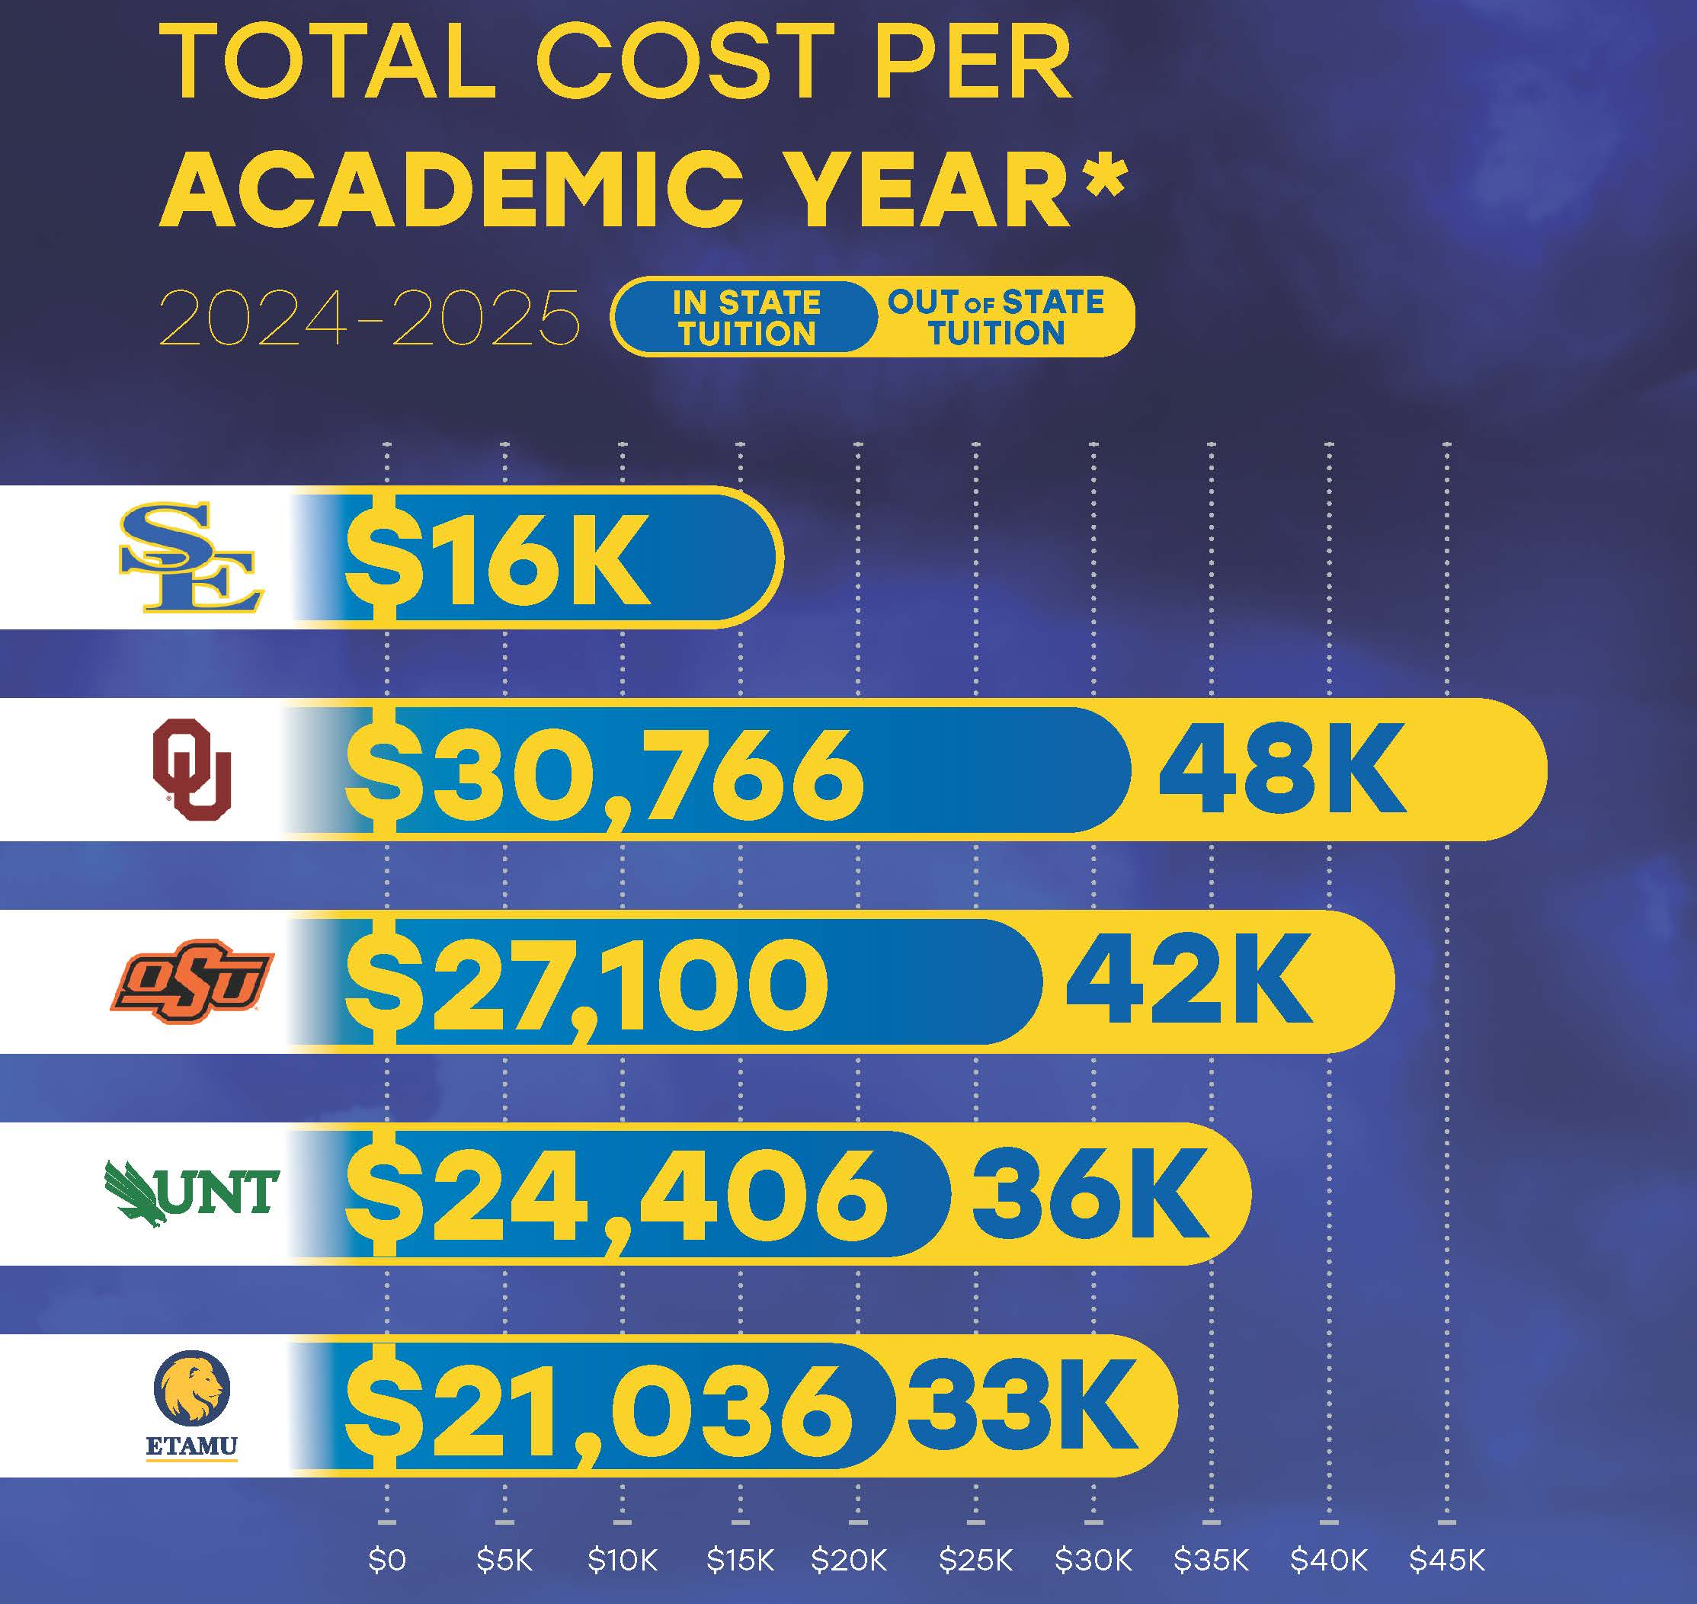
Background

Slide 5
Strategic Objectives and Initiatives
1. Need-Based Financial Aid
Objective: Increase direct support for university scholarships by $1,000,000 over the next 5 years.
Actions:
Foundation Fundraising: Southeastern has successfully increased foundation total assets by 20% over the past five years, resulting in more scholarships being offered each year. In 2024-2025, The Southeastern Foundation accounted for almost $1,200,000 in direct scholarships to students and with additional support from other foundations and friends the University saw almost $1,4000,000 in support for students this year, a record high at Southeastern.
Scholarship Campaigns: Launch targeted fundraising campaigns to secure additional donations for need-based scholarships, emphasizing community and alumni engagement. The blueprint for these campaigns has been established at Southeastern, most recently with the John Massey Leadership Scholars program that will support $400,000 per year in ongoing student scholarships in 2026 when the program reached full maturity.
Giving Day Campaigns: Giving Day has also resulted in additional dollars for specific scholarships.

Slide 6
Strategic Objectives and Initiatives
2. Tuition and Fee Reorganization
Objective: Enhance transparency in tuition pricing.
Actions:
Separate Tuition and Fees: Analyze the potential to itemize tuition and fees, allowing students to see the true cost of their specific degree programs. Southeastern already has one of the most transparent pricing structures among Oklahoma Institutions with very few mandatory fees and academic services fees that are specific to support programmatic outcomes. Southeastern will continue to support this philosophy when proposing cost increases and continually evaluate current tuition and fee structures to ensure that they are applicable to real world student outcomes and support affordability in relationship to university operating costs while controlling student debt.

Slide 7
Strategic Objectives and Initiatives
3. Tuition and Fees Pricing Strategy
Objective: Ensure tuition is appropriate and supportive of student success.
Actions:
Tuition and Fee Study: Conduct a tuition study to ensure that tuition is consistent with the market and consistent with career outcomes as a function of graduate return on investment.

Slide 8
Strategic Objectives and Initiatives
4. Income-Share Agreements
Objective: Expand partnerships to cover education costs.
Actions:
Local Hospital Partnership: Explore possible relationship with hospital precipitated by new nursing program to support costs of program through faculty, clinicals, and scholarships.
Co-Op Program Expansion: Expand student internship and co-op opportunities with Choctaw Nation and develop new opportunities using this model with other local and regional organizations and businesses.
Two-Year Pathways: Expand opportunities for student transfer from local two-year colleges to include Murray State and Eastern Oklahoma to ensure students can transfer credits more seamlessly with degree completion in mind.

Slide 9
Strategic Objectives and Initiatives
5. Acceleration Degree Programs and Evaluation of Current Degree Requirements
Objective: Increase opportunities for students to receive credits for prior learning.
Actions:
Micro Credentials: Explore potential for micro-credentials to count as academic credits towards a degree.
Credits for Prior Learning/90 Hour Bachelors: Expand partnerships with two-years schools as a pathway to a credential or degree in specific fields to support Oklahoma workforce needs.

Slide 10
Strategic Objectives and Initiatives
5. Acceleration Degree Programs and Evaluation of Current Degree Requirements
Objective: Evaluate length of both undergraduate and graduate degree programs to ensure programs degree requirements are consistent with best practice and similar degree requirements at other similar universities.
Actions:
Masters: Evaluate recent reduction in MBA credit requirements to ensure compliance with AACSB standards. Evaluate requirements for M.Ed. to potentially decrease cost and build capacity for potential Ed.D. while ensuring academic rigor and quality.
Bachelors: Develop pathway to move all undergraduate degrees to 120 credit hour level while ensuring academic rigor and quality.
Program Evaluation: Continue to evaluate programs and adjust as necessary for efficiency based on Oklahoma State Regents for Higher Education. Over the last four years Southeastern has eliminated two programs that include Special Education – Mild/Moderate Disabilities, and Spanish.

Slide 11
Strategic Objectives and Initiatives
6. Online and Hybrid Learning Options
Objective: Broaden affordable online learning opportunities.
Actions:
Healthcare Programs: Launch new RN to BSN program.
Expand Certificate and Micro Credential Program: Explore additional certificate and Micro Credential programs that are both credit earning and stackable within current degree programs with an intent to support workforce development.

Slide 12
Strategic Objectives and Initiatives
7. University and Community Partnerships
Objective: Strengthen transfer pathways for students.
Actions:
Current MOU: Maintain a Memorandum of Understanding (MOU) with the local community colleges for seamless transfer.
Future Goals: Establish new Memorandums of Understanding (MOU) with four-year universities to support workforce development in specific programs of hospitality management, gaming, business, and nursing. Other program opportunities should be identified and evaluated with the goal of improving workforce outcomes that support skills needed to support Oklahoma

Slide 13
Strategic Objectives and Initiatives
8. Open Educational Resources
Objective: Reduce textbook costs for students.
Actions:
Encourage OER Use: Promote the adoption of OER and other cost-saving measures among faculty.
Cost Comparison: Demonstrate that while textbooks can cost students significantly, many course materials at Southeastern are offered for free.

Slide 14
Strategic Objectives and Initiatives
9. Merit-Based Automatic Scholarships
Objective: Increase funding for merit-based automatic scholarships.
Actions:
Annual Increase: Increase merit-based scholarships by 5% each year over the next three years, leveraging philanthropic support.

Slide 15
Strategic Objectives and Initiatives
10. Decrease Operational Expenses and University Debt
Objective: Improve financial sustainability.
Actions:
Academic Structure: Evaluate current academic structure based on program size and outcomes to determine if current structure best serves students and is operationally efficient.
Operational Cost: Evaluate opportunities for outsourcing of services that may promote efficiency, alleviate workload on current staff, and provide more cost-effective support for university operations.
Formally Adopt Debt Strategy: Develop a strategy to reduce debt while continuing to support growth and campus improvements through responsible use of debt.

Slide 16
Strategic Objectives and Initiatives
11. Enhance Efficiency and Productivity
Objective: Increase efficiency, reduce costs and improve accessibility.
Actions:
Implement Transcript Processing Solution: Automate transcription of college and high school transcripts, as well as standardized test scores, leading to greater resource utilization, allowing staff to focus on high-level tasks and initiatives while ensuring cost-effectiveness and scalability for future growth. As Southeastern continues to modernize the educational experience for its students, a continued focus is placed on enhancing operational efficiency, compliance, and accuracy with our data management processes.

Slide 17
RUSO Affordability and Plan

