Slide 1
Determine the sign of both velocity (v) and acceleration (a) of Karl, with respect to the designated observer.
v<0, a<0
v<0, a>0
v>0, a<0
v>0, a>0

Slide 2
Determine the sign of both velocity (v) and acceleration (a) of Karl, with respect to the designated observer.
v<0, a<0
v<0, a>0
v>0, a<0
v>0, a>0

Slide 3
Determine the sign of both velocity (v) and acceleration (a) of Karl, with respect to the designated observer.
v<0, a<0
v<0, a>0
v>0, a<0
v>0, a>0

Slide 4
Determine the sign of both velocity (v) and acceleration (a) of Karl, with respect to the designated observer.
v<0, a<0
v<0, a>0
v>0, a<0
v>0, a>0

Slide 5
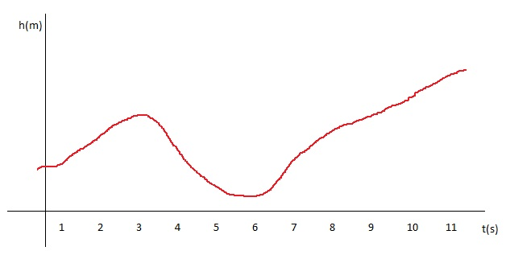
The graph depicts height (in meters) versus time (in seconds). At what time(s) is velocity zero?
1 s
2 s
3 s
4 s
5 s
6 s
7 s
8 s
9 s
10 s

Slide 6
You throw a ball straight up into the air. After it is released, when is acceleration positive (in the upwards direction)?
until it reaches max height
between max height and hitting the ground
always
never

