Slide 1
If two vehicles are traveling in opposite directions, both at 10 mph, will the relative velocity between the two be 20 mph?
True
False

Slide 2
If two vehicles are traveling in opposite directions, both at 0.75 times the speed of light, will the relative velocity between the two be 1.5 times the speed of light?
True
False

Slide 3
It is possible to have no acceleration if motion is not in a straight line.
True
False

Slide 4
What initial angle (in degrees) maximizes horizontal range in projectile motion?
Rank | Responses
1
2
3
4
5
6

Slide 5
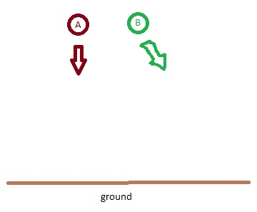
Two balls are dropped from the same height. Ball A is simply released and travels perpendicularly to the ground. Ball B is given horizontal displacement when released. Which hits the ground first?
Ball A
Ball B
They both hit the ground at the same time

Slide 6
Determine the sign of both velocity (v) and acceleration (a) of Karl, with respect to the designated observer.
v<0, a<0
v<0, a>0
v>0, a<0
v>0, a>0

