Slide 1
The sign of velocity, position and acceleration depend upon the location of an observer.
True
False

Slide 2
Determine the sign of both velocity (v) and acceleration (a) of Karl, with respect to the designated observer.
v<0, a<0
v<0, a>0
v>0, a<0
v>0, a>0

Slide 3
Determine the sign of both velocity (v) and acceleration (a) of Karl, with respect to the designated observer.
v<0, a<0
v<0, a>0
v>0, a<0
v>0, a>0

Slide 4
Determine the sign of both velocity (v) and acceleration (a) of Karl, with respect to the designated observer.
v<0, a<0
v<0, a>0
v>0, a<0
v>0, a>0

Slide 5
Determine the sign of both velocity (v) and acceleration (a) of Karl, with respect to the designated observer.
v<0, a<0
v<0, a>0
v>0, a<0
v>0, a>0

Slide 6
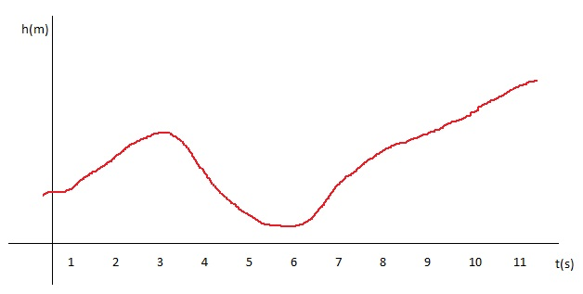
The graph depicts height (in meters) versus time (in seconds). At what time(s) is velocity zero?
1 s
2 s
3 s
4 s
5 s
6 s
7 s
8 s
9 s
10 s

