Slide 1
According to Newton’s Third Law, F_{A on B} =
F_{B on A}
-F_{A on B}
-F_{B on A}

Slide 2
Suppose that a person is standing on a scale in an elevator when the elevator begins to accelerate upward. According to Newton's Third Law, which one of the following forces will be equal and opposite to the force the person exerts on the scale (which is what the scale will read)?
The normal force exerted on the person by the scale.
The person's mass times their acceleration.
The person's weight.
The force exerted on the scale by the elevator

Slide 3
An object in motion cannot be in equilibrium.
True
False

Slide 4
∑F_{x} = ma_{x}, ∑F_{y} = ma_{y} is….
Newton’s First Law
Newton’s Second Law
Newton’s Third Law
Equilibrium Equation

Slide 5
Free-body diagrams can only be drawn for an object if it is not accelerating.
True
False

Slide 6
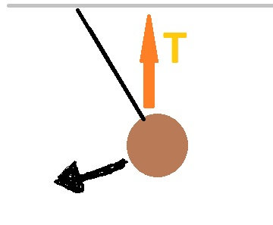
Tension force is drawn correctly in this picture:
True
False

