Slide 1
Every object composed of matter exerts a force upon all other objects composed of matter.
True
False

Slide 2
Newton’s Law of Gravitation can be used to compute a person’s weight.
True
False

Slide 3
Weight = mass * gravity
True
False

Slide 4
The force that you exert on the Earth is ______ the force the Earth exerts on you.
less than
equal to
more than

Slide 5
The moon is pulled directly toward the Earth by Newton’s Law of Gravitation. Why does the moon not collide into the Earth?
Net force is zero.
Newton’s 3rd Law.
The moon is constantly falling towards the Earth.

Slide 6
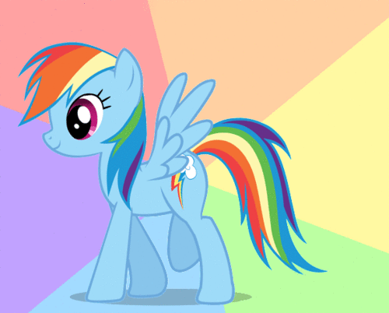
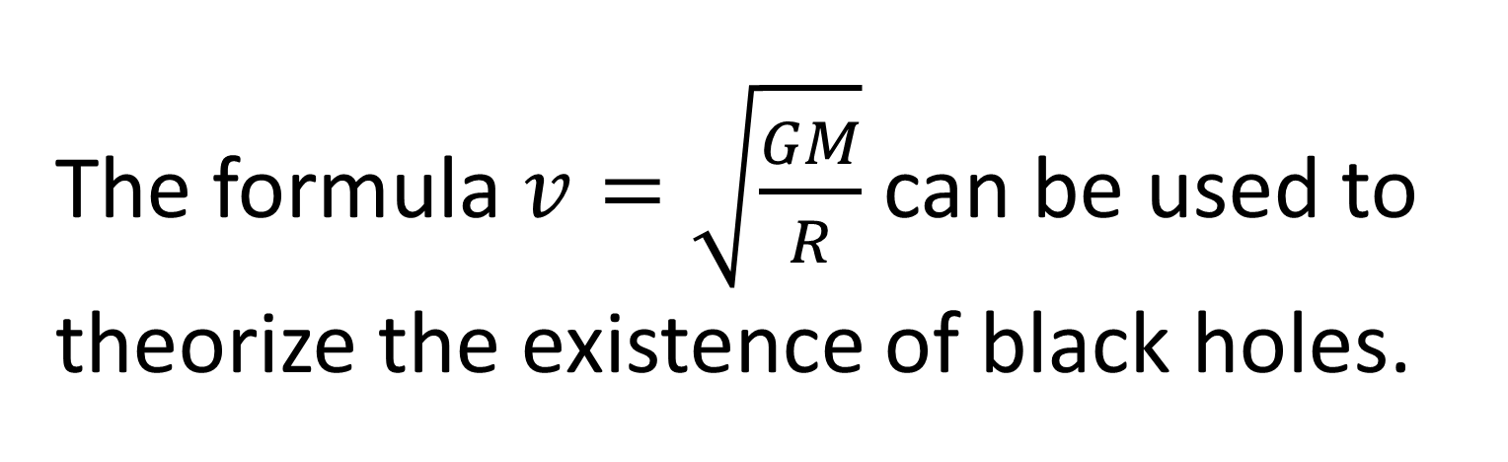
The formula $v=\sqrt{\frac{GM}{R}}$ can be used to theorize the existence of black holes.
True
False

