Slide 1
Friction creates energy in the form of heat.
True
False

Slide 2
The SI unit of energy is the
Newton
Joule
Slug
Calorie

Slide 3
The SI unit of work is the
Joule-meter
Joule
Calorie
Slug meter

Slide 4
The work done on an object by external forces can be computed without knowing potential energies.
True
False

Slide 5
Work can be negative
True
False

Slide 6
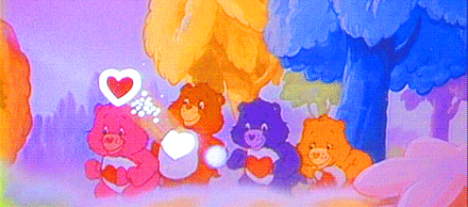
The Earth does work on the moon to keep the moon in orbit about the Earth.
True
False

