Slide 1
The equations for circular motion are identical to those of linear motion except for variable names.
True
False

Slide 2
The equations of angular motion are valid for θ in degrees or radians.
True
False

Slide 3
Two objects are on a rotating disk. Object A is half the distance from the center of the disk as object B. Which object has a larger angular velocity?
Object A
Object B
They have the same angular velocity at any given time

Slide 4
Two objects are on a rotating disk. Object A is half the distance from the center of the disk as object B. Which object has a larger angular velocity?
Object A
Object B
They both have the same linear velocity at any given time.

Slide 5
Under constant acceleration, linear velocity is related linearly to
Angular velocity
Radius of rotation
Neither A or B
Both A and B

Slide 6
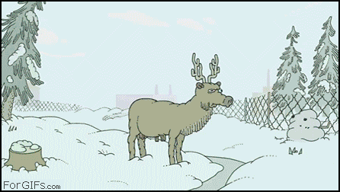
Radial acceleration can be written in terms of either angular or linear velocity.
Well of course!
Of course not, that would be silly.

