Slide 1
The SI units of torque is
torques
newtons
joules
newton-meters

Slide 2
For a fixed force F, the amount of torque _____ the further from the pivot the force is applied.
increases
decreases
does not change

Slide 3
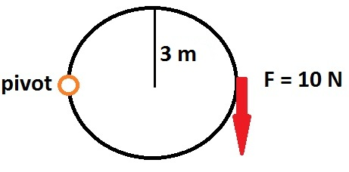
Compute torque for the following:
30 N*m
60 N*m
15 $\sqrt{2}$ N*m
0 N*m

Slide 4
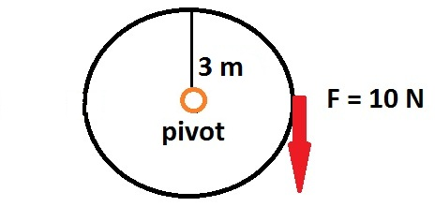
Compute torque for the following:
30 N*m
60 N*m
15 $\sqrt{2}$ N*m
0 N*m

Slide 5
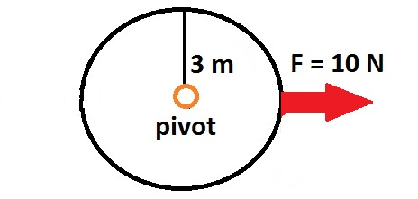
Compute torque for the following:
30 N*m
60 N*m
15 $\sqrt{2}$ N*m
0 N*m

Slide 6
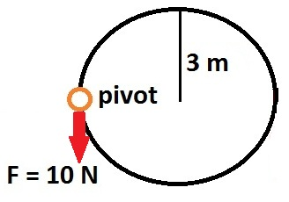
Compute torque for the following:
30 N*m
60 N*m
15 $\sqrt{2}$ N*m
0 N*m

