Slide 1
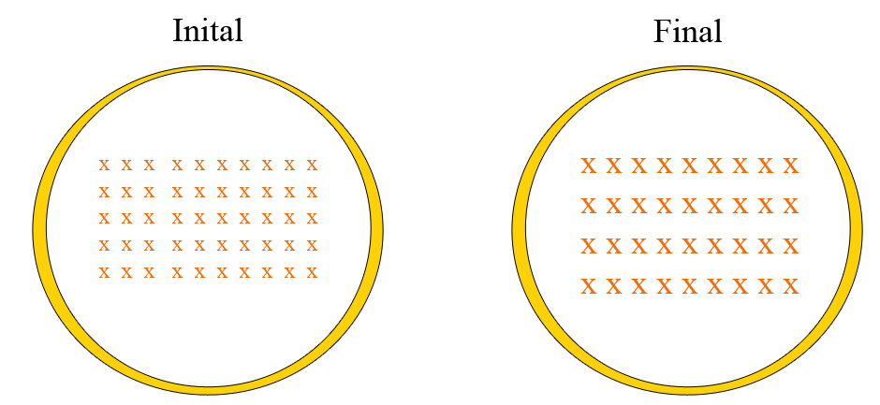
Find the direction of the induced magnetic field given the following change in magnetic field strength.
Into the page
Out of the page

Slide 2
Find the direction the current in the coil given the following change in magnetic field.
Clockwise
Counter-clockwise
No current is present

Slide 3
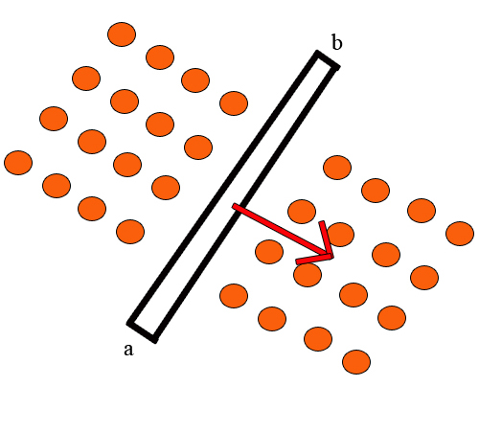
A conducting rod (black) in a magnetic field (orange) is moving with velocity v (red). Find the direction of the force the magnetic field exerts on the bar.
From a to b
From b to a
Out of the picture
Into the picture

Slide 4
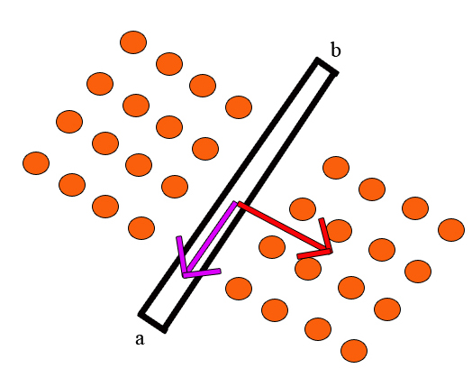
A conducting rod (black) in a magnetic field (orange) is moving with velocity (red) and the direction of the force the magnetic field exerts on the bar points towards a (pink). What direction is the electric field on the conducting rod?
From a to b
From b to a
Out of the picture
Into the picture

Slide 5
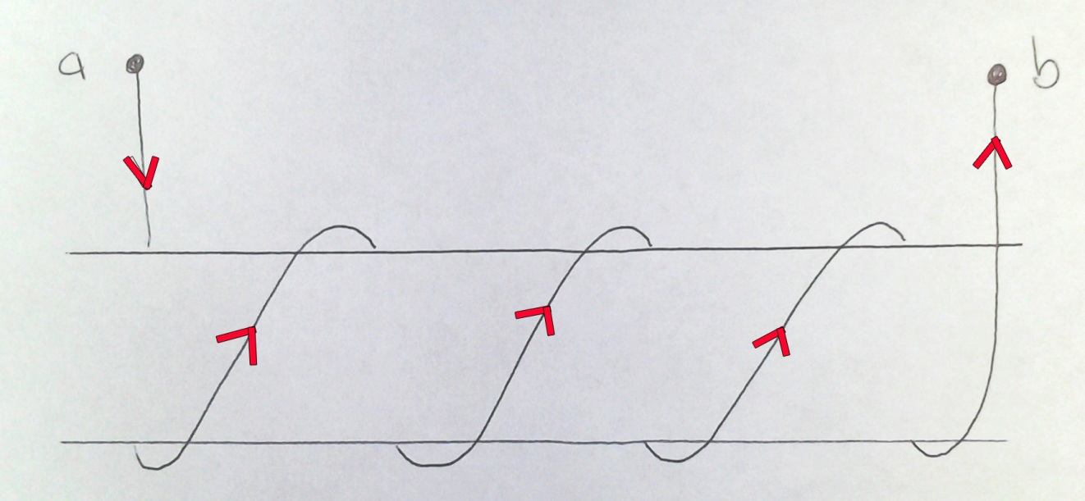
Find the direction the magnetic field in the coil given that the current moves from a to b.
To the left
To the right
Down
Up
Into the page
Out of the page

