Slide 1
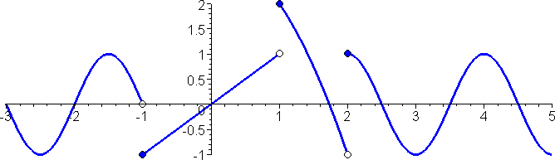
On the interval [-2, 4], at how may points does a limit not exist?
0
1
2
3
4

Slide 2
On the interval [-2, 4], at how may points does a limit from the left not exist?
0
1
2
3
4

Slide 3
On the interval [-2, 4], at how may points does a limit from the left not equal the actual function value?
0
1
2
3
4

Slide 4
On the interval [-2, 4], at how may points does a limit from the right not equal the actual function value?
0
1
2
3
4

Slide 5
For rational functions, for any real number a, the limit at x=a is always f(a).
True
False

Slide 6
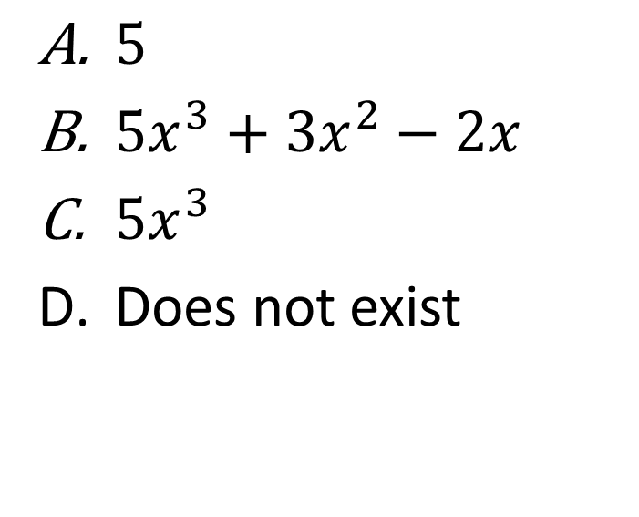
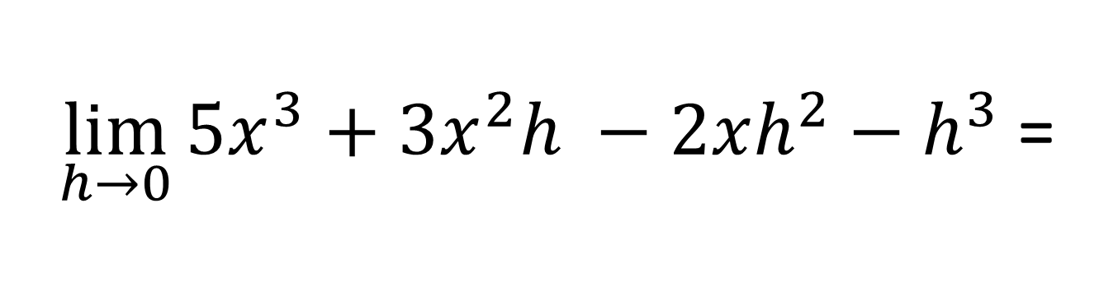
$\lim_{h→0}{5x^{3}+3x^{2}h −2xh^{2}−h^{3}}$ =
$5$
$5x^{3}+3x^{2}−2x$
$5x^{3}$
Does not exist

Slide 7

$$\lim_{x→1}{\frac{x^{3}−1}{x−1}}=$$
Rank | Responses
1
2
3
4
5
6

