Slide 1
For what value of $c$ will the following function be continuous at $x=1$. $$f\left(x\right)= \left\{\begin{aligned}x^{2}−2x+4, x ≤1 \\ 2x−c, x>1\end{aligned}\right.$$
Rank | Responses
1
2
3
4
5
6

Slide 2
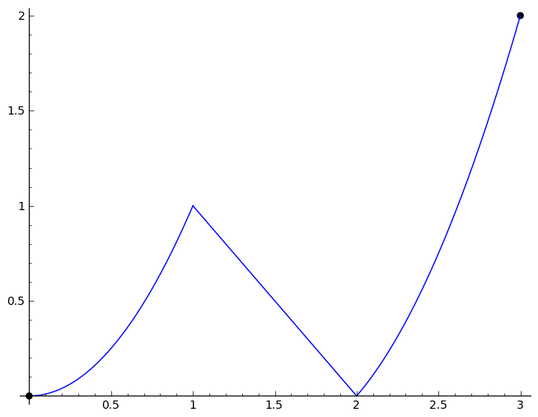
The following graph is continuous everywhere on the interval (0, 3).
True
False

Slide 3
$$\lim_{x→2^{−}}{f\left(x\right)= }$$
Rank | Responses
1
2
3
4
5
6

Slide 4
For a function f(x), where x has units feet and f is measured in pounds, the units on the average rate of change of f(x) are:
Pound * feet
Pounds per foot
Foot per pounds

Slide 5
For $f\left(x\right)=3x^{2}−2x+1$, find the difference quotient when $x=$1 and $h=2$.
Rank | Responses
1
2
3
4
5
6

Slide 6
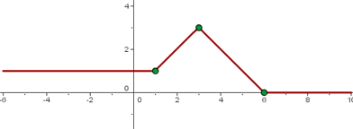
For the following graph, on what interval is the rate of change positive?
(-6, 1)
(1, 3)
(3, 6)
(6, 10)
All of the above
None of the above

