Slide 1
$$f\left(x\right)=\left\{\begin{aligned}\frac{x^{3}−1}{x−1}, x≠1 \\ &c, x=1\end{aligned}\right.$$ For what value of c is f(x) continuous at x=1?
Rank | Responses
1
2
3
4
5
6

Slide 2
Find the difference quotient for f(x) = 2x+3
$\frac{2x−2h}{h}$
$\frac{2x+3}{2h+3}$
$2$
$\frac{2x+2h}{h}$
$\frac{2x+3+h}{h}$
None of the above

Slide 3
Find f’(x) if f(x) = 2x+3
$\frac{2x−2h}{h}$
$\frac{2x+3}{2h+3}$
$2$
$\frac{2x+2h}{h}$
$\frac{2x+3+h}{h}$
None of the above

Slide 4
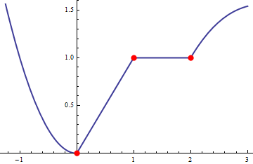
For the function on the left, on which of the given intervals is f’(x) > 0?
(-1, 0)
(0, 1)
(1, 2)
(2, 3)
None of the above

Slide 5
For the function on the left, on which of the given intervals is f’(x) < 0?
(-1, 0)
(0, 1)
(1, 2)
(2, 3)
None of the above

Slide 6
For the function on the left, on which of the given intervals is f’(x) = 0?
(-1, 0)
(0, 1)
(1, 2)
(2, 3)
None of the above

Slide 7
For the function on the left, at how many points does f’(x) not exist?
0
1
2
3
4

