Slide 1
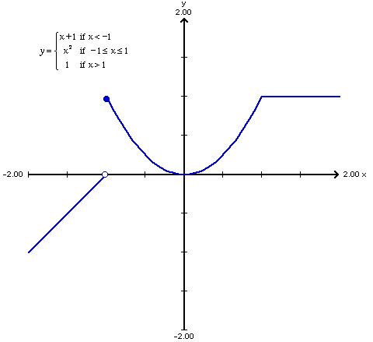
At how many points for the given function does the limit not exist?
Rank | Responses
1
2
3
4
5
6

Slide 2
At how many points for the given function does the limit from the left not exist?
Rank | Responses
1
2
3
4
5
6

Slide 3
At how many points is the given function not continuous ?
Rank | Responses
1
2
3
4
5
6

Slide 4
At how many points is the given function not differentiable ?
Rank | Responses
1
2
3
4
5
6

Slide 5
For the given function, what is f’(x) for x < 1?
1
x
2x
0
x+1

Slide 6
For the given function, what is f’(x) for -1< x < 1?
1
x
2x
0
x+1

