Slide 1
If an object is traveling north at 30 m/s and east at 13 m/s, what is the objects speed?
Rank | Responses
1
2
3
4
5
6

Slide 2
An object is traveling north at 30 m/s and east at 13 m/s. In what direction (East of North), to the nearest degree, is the object traveling?
Rank | Responses
1
2
3
4
5
6

Slide 3
Vectors have two properties.
x- and y-components
direction and magnitude
an arrow and a colour
a resultant and displacement

Slide 4
$<1, 3, −1>+<2, 3, 0> =$
cannot be done, too many components!
$<2, 9, 0>$
$<3, 6, −1>$

Slide 5
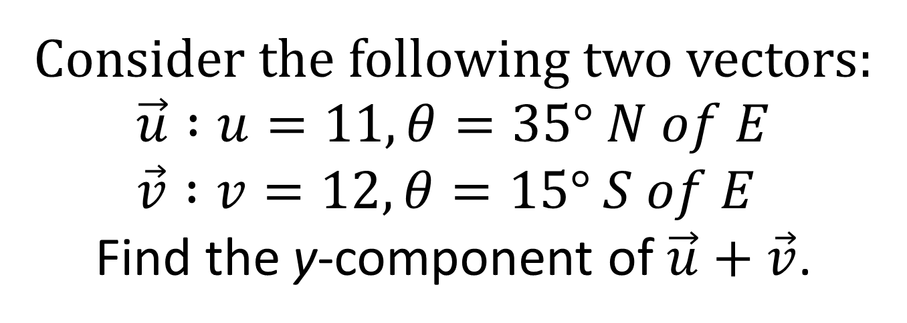
Consider the following two vectors: $$\vec{u} :u=11, θ=35° N of E \\ \vec{v} :v=12, θ=15° S of E$$ Find the y-component of $\vec{u}+\vec{v}$.
Rank | Responses
1
2
3
4
5
6

Slide 6
Consider the equation:$x=\frac{1}{2}g t^{2}$ Here, $x$ has units meters and $t$ has units seconds. What must the units on $g$ be?
Meters/second
Meters²/second
Meters/second²
Meters²/second²
1/second²
Meters

