Slide 1
Given two functions, f(x) and g(x), f(g(x)) = g(f(x))
True
False

Slide 2
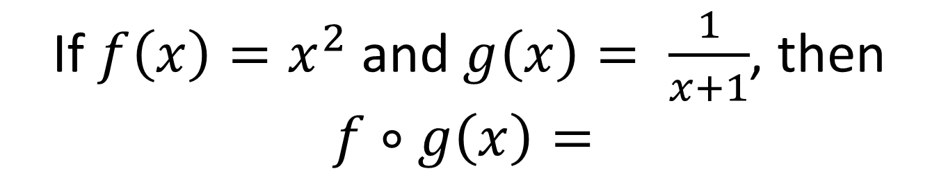
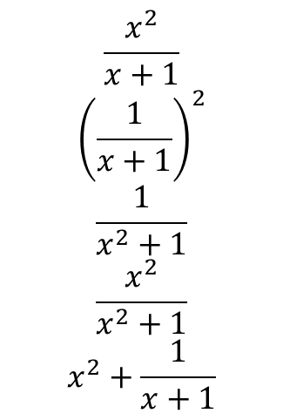
If $f\left(x\right)=x^{2}$ and $g\left(x\right)= \frac{1}{x+1}$, then
$$f∘g\left(x\right)=$$
$$\frac{x^{2}}{x+1}$$
$${\left(\frac{1}{x+1}\right)}^{2}$$
$$\frac{1}{x^{2}+1}$$
$$\frac{x^{2}}{x^{2}+1}$$
$$x^{2}+\frac{1}{x+1}$$

Slide 3
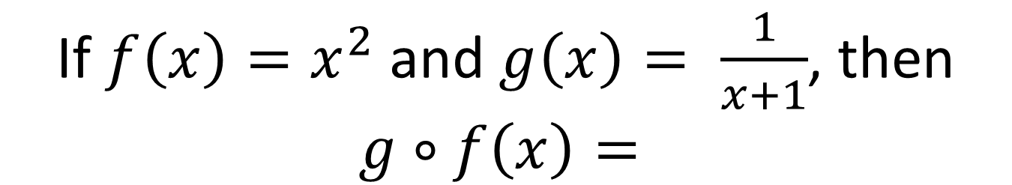
If $f\left(x\right)=x^{2}$ and $g\left(x\right)= \frac{1}{x+1}$, then
$$g∘f\left(x\right)=$$
$$\frac{x^{2}}{x+1}$$
$${\left(\frac{1}{x+1}\right)}^{2}$$
$$\frac{1}{x^{2}+1}$$
$$\frac{x^{2}}{x^{2}+1}$$
$$x^{2}+\frac{1}{x+1}$$

Slide 4
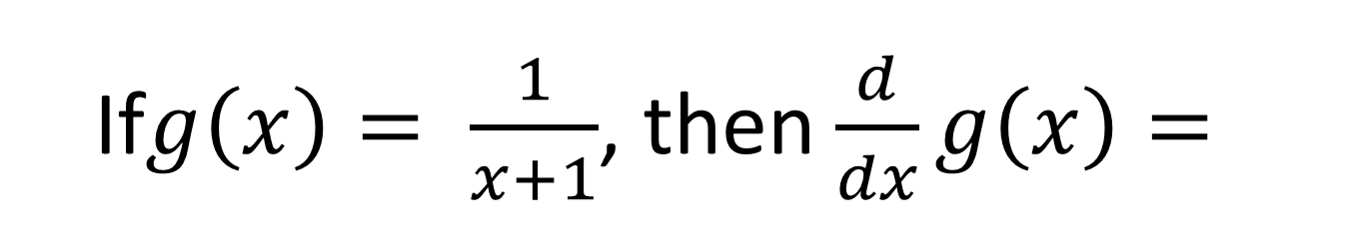
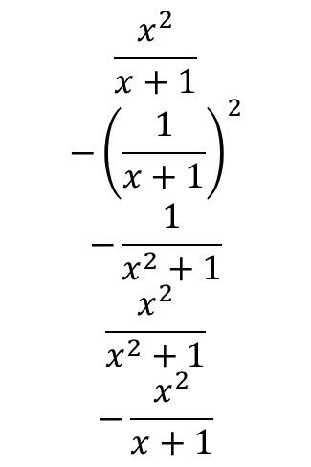
If$g\left(x\right)= \frac{1}{x+1}$, then $\frac{d}{dx}g\left(x\right)=$
$$\frac{x^{2}}{x+1}$$
$${−\left(\frac{1}{x+1}\right)}^{2}$$
$$−\frac{1}{x^{2}+1}$$
$$\frac{x^{2}}{x^{2}+1}$$
$$−\frac{x^{2}}{x+1}$$

Slide 5
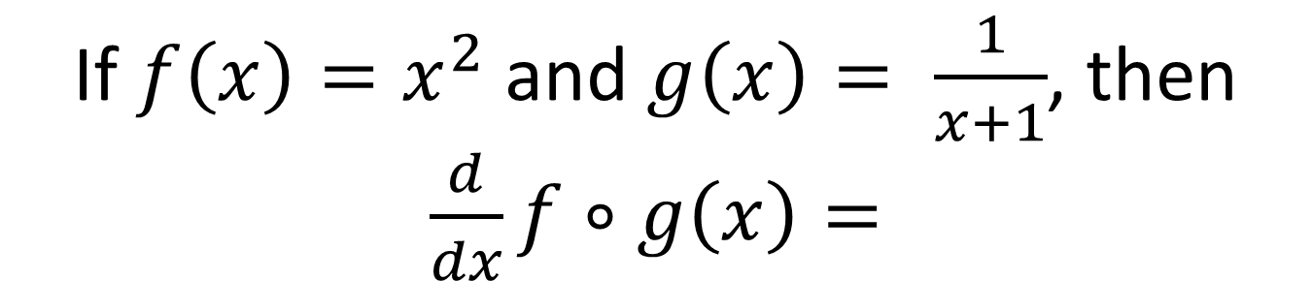
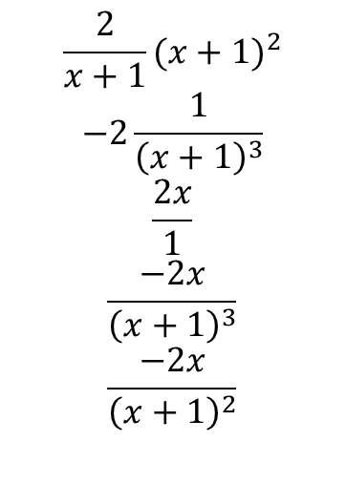
If $f\left(x\right)=x^{2}$ and $g\left(x\right)= \frac{1}{x+1}$, then $\frac{d}{dx}f∘g\left(x\right)=$
$$\frac{2}{x+1}{(x+1)}^{2}$$
$$−2\frac{1}{{\left(x+1\right)}^{3}}$$
$$\frac{2x}{1}$$
$$\frac{−2x}{{\left(x+1\right)}^{3}}$$
$$\frac{−2x}{{\left(x+1\right)}^{2}}$$

Slide 6

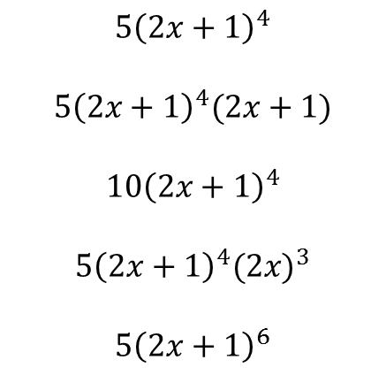
Compute $\frac{d}{dx}{\left(2x+1\right)}^{5}$
$${5\left(2x+1\right)}^{4}$$
$$5{\left(2x+1\right)}^{4}(2x+1)$$
$${10\left(2x+1\right)}^{4}$$
$$5{\left(2x+1\right)}^{4}{(2x)}^{3}$$
$$5{\left(2x+1\right)}^{6}$$

