Slide 1
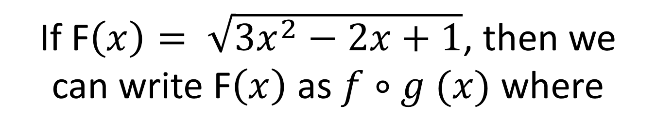
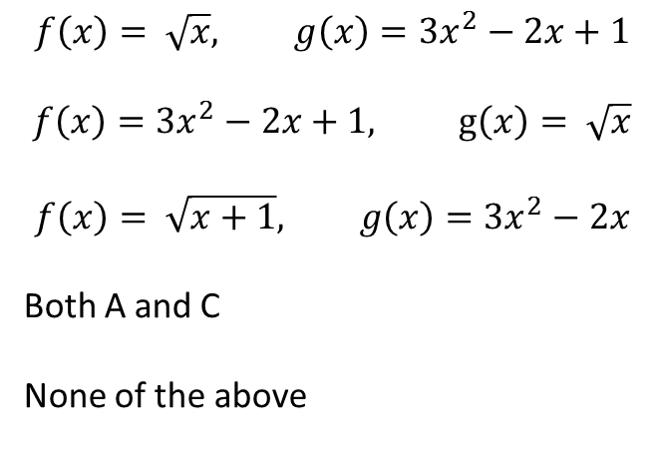
If F$\left(x\right)= \sqrt{3x^{2}−2x+1}$, then we can write F$\left(x\right)$ as $f∘g (x)$ where
$$f\left(x\right)= \sqrt{x}, g\left(x\right)=3x^{2}−2x+1$$
$$f\left(x\right)=3x^{2}−2x+1, g\left(x\right)= \sqrt{x}$$
$$f\left(x\right)= \sqrt{x+1}, g\left(x\right)=3x^{2}−2x$$
Both A and C
None of the above

Slide 2
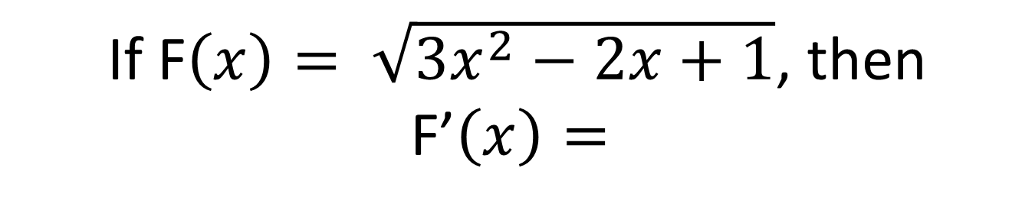
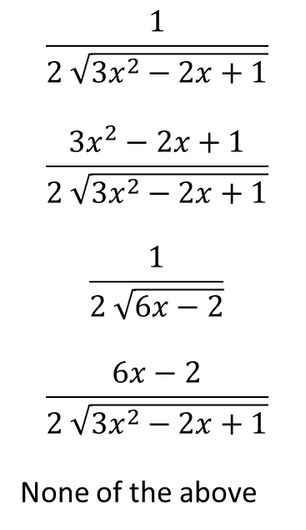
If F$\left(x\right)= \sqrt{3x^{2}−2x+1}$, then F’$\left(x\right)=$
$$\frac{1}{2 \sqrt{3x^{2}−2x+1}}$$
$$\frac{3x^{2}−2x+1}{2 \sqrt{3x^{2}−2x+1}}$$
$$\frac{1}{2 \sqrt{6x−2}}$$
$$\frac{6x−2}{2 \sqrt{3x^{2}−2x+1}}$$
None of the above

Slide 3
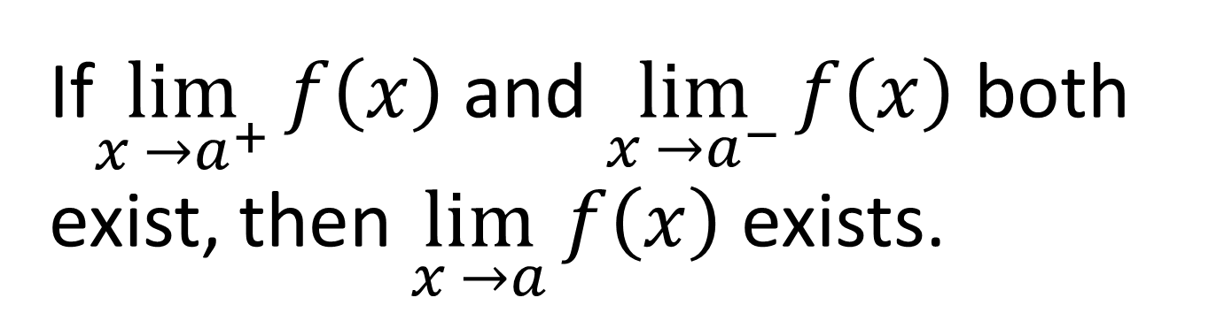
If$\lim_{x →a^{+}}{f\left(x\right)}$ and $\lim_{x →a^{−}}{f\left(x\right)}$both exist, then $\lim_{x →a}{f\left(x\right)}$ exists.
True
False

Slide 4
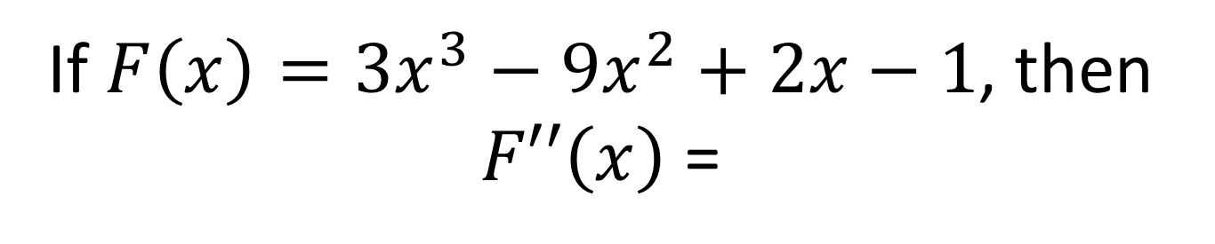
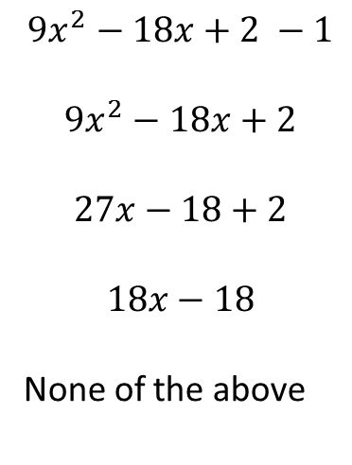
If $F\left(x\right)=3x^{3}−9x^{2}+2x−1$, then $F′′\left(x\right)$ =
$$9x^{2}−18x+2 −1$$
$$9x^{2}−18x+2$$
$$27x−18+2$$
$$18x−18$$
None of the above

Slide 5
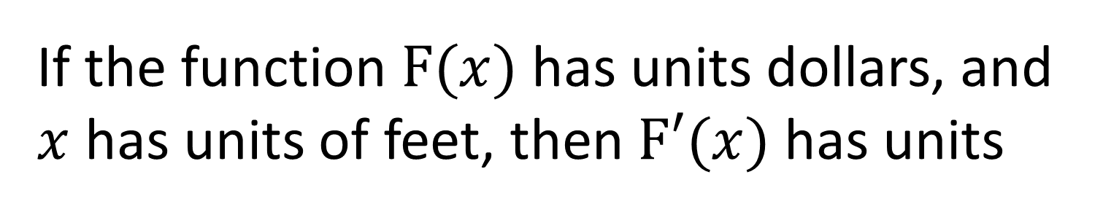
If the function $F(x)$ has units dollars, and $x$ has units of feet, then $F′(x)$ has units
dollars*feet
dollars/foot
feet/dollar
dollars
none of the above

Slide 6
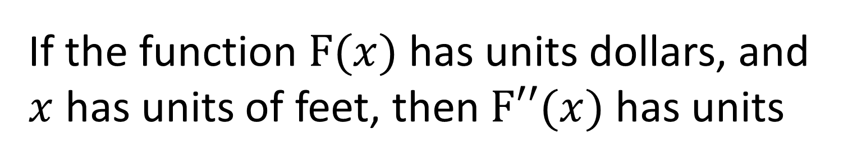
If the function $F(x)$ has units dollars, and $x$ has units of feet, then $F′′(x)$ has units
dollars*feet²
dollars/foot²
feet²/dollar
dollars²
none of the above

