Slide 1
If f(x) has a critical point at x=a, then f’(a) = 0
True
False

Slide 2
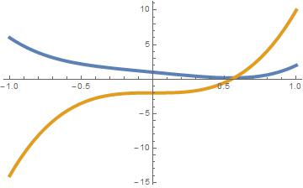
F is blue, F’ is yellow
F is yellow, F’ is blue
The curves are not related by d/dx

Slide 3
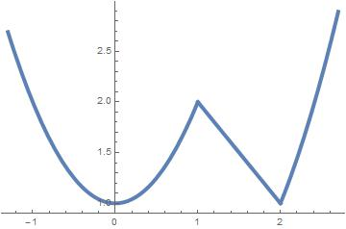
At how many points does f’(x) = 0 on the interval [-1.5, 2.5]?
0
1
2
3

Slide 4
At how many points does f’(x) not exist on the interval [-1.5, 2.5]?
0
1
2
3

Slide 5
How many critical points does f(x) have on the interval [-1.5, 2.5]?
0
1
2
3

Slide 6
How many relative minimums does f(x) have on the interval [-1.5, 2.5]?
0
1
2
3

Slide 7
How many relative maximums does f(x) have on the interval [-1.5, 2.5]?
0
1
2
3

