Slide 1
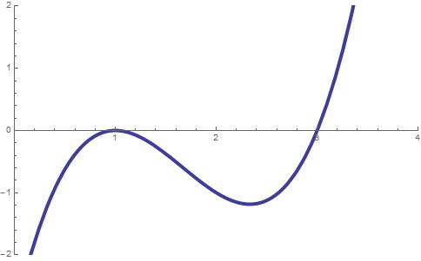
The graph of f(x) is depicted on the left. At x=0.5,
f(x) < 0, f’(x) > 0, f’’(x) > 0
f(x) < 0, f’(x) < 0, f’’(x) > 0
f(x) < 0, f’(x) > 0, f’’(x) < 0
f(x) > 0, f’(x) > 0, f’’(x) < 0
f(x) > 0, f’(x) > 0, f’’(x) = 0
f(x) > 0, f’(x) = 0, f’’(x) = 0
None of the above

Slide 2
The graph of f(x) is depicted on the left. At x=1.0,
f(x) = 0, f’(x) = 0, f’’(x) > 0
f(x) = 0, f’(x) < 0, f’’(x) < 0
f(x) = 0, f’(x) > 0, f’’(x) < 0
f(x) = 0, f’(x) = 0, f’’(x) < 0
f(x) = 0, f’(x) = 0, f’’(x) = 0
f(x) > 0, f’(x) = 0, f’’(x) = 0
None of the above

Slide 3
The graph of f(x) is depicted on the left. At x=1.2,
f(x) < 0, f’(x) > 0, f’’(x) > 0
f(x) < 0, f’(x) < 0, f’’(x) < 0
f(x) < 0, f’(x) > 0, f’’(x) < 0
f(x) > 0, f’(x) > 0, f’’(x) < 0
f(x) > 0, f’(x) > 0, f’’(x) = 0
f(x) > 0, f’(x) = 0, f’’(x) = 0
None of the above

Slide 4
The graph of f(x) is depicted on the left. At x=1.6,
f(x) < 0, f’(x) > 0, f’’(x) > 0
f(x) < 0, f’(x) < 0, f’’(x) < 0
f(x) < 0, f’(x) < 0, f’’(x) = 0
f(x) > 0, f’(x) = 0, f’’(x) < 0
f(x) > 0, f’(x) > 0, f’’(x) = 0
f(x) < 0, f’(x) = 0, f’’(x) = 0
None of the above

Slide 5
The graph of f(x) is depicted on the left. At x=2.1,
f(x) < 0, f’(x) > 0, f’’(x) > 0
f(x) < 0, f’(x) < 0, f’’(x) < 0
f(x) < 0, f’(x) < 0, f’’(x) = 0
f(x) < 0, f’(x) < 0, f’’(x) > 0
f(x) > 0, f’(x) > 0, f’’(x) = 0
f(x) < 0, f’(x) = 0, f’’(x) = 0
None of the above

Slide 6
The graph of f(x) is depicted on the left. At x=2.3,
f(x) < 0, f’(x) > 0, f’’(x) > 0
f(x) < 0, f’(x) = 0, f’’(x) < 0
f(x) < 0, f’(x) < 0, f’’(x) = 0
f(x) < 0, f’(x) = 0, f’’(x) > 0
f(x) < 0, f’(x) > 0, f’’(x) = 0
f(x) < 0, f’(x) = 0, f’’(x) = 0
None of the above

Slide 7
The graph of f(x) is depicted on the left. At x=3.0,
f(x) = 0, f’(x) > 0, f’’(x) > 0
f(x) = 0, f’(x) = 0, f’’(x) < 0
f(x) = 0, f’(x) < 0, f’’(x) = 0
f(x) = 0, f’(x) = 0, f’’(x) > 0
f(x) = 0, f’(x) > 0, f’’(x) = 0
f(x) = 0, f’(x) = 0, f’’(x) = 0
None of the above

