Slide 1
Let $f\left(x\right)= x^{3}+2x^{2}−3x$. Two roots are at x=0 and x=1, where is the third root?
Rank | Responses
1
2
3
4
5
6

Slide 2
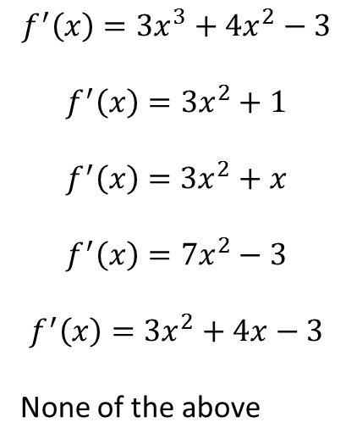
Let $f\left(x\right)= x^{3}+2x^{2}−3x$. What is f’(x)?
$$f^{′}\left(x\right)=3x^{3}+4x^{2}−3$$
$$f^{′}\left(x\right)=3x^{2}+1$$
$$f^{′}\left(x\right)=3x^{2}+x$$
$$f^{′}\left(x\right)=7x^{2}−3$$
$$f^{′}\left(x\right)=3x^{2}+4x−3$$
None of the above

Slide 3
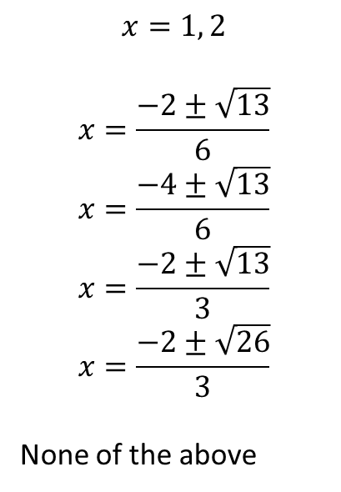
Let $f\left(x\right)= x^{3}+2x^{2}−3x$. Then $f^{′}\left(x\right)=3x^{2}+4x−3$. Where does f’(x) = 0?
$$x=1, 2$$
$$x=\frac{−2±\sqrt{13}}{6}$$
$$x=\frac{−4±\sqrt{13}}{6}$$
$$x=\frac{−2±\sqrt{13}}{3}$$
$$x=\frac{−2±\sqrt{26}}{3}$$
None of the above

Slide 4
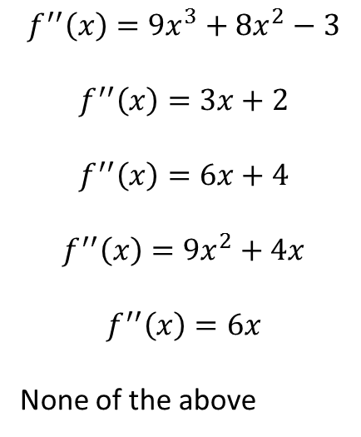
Let $f\left(x\right)= x^{3}+2x^{2}−3x$. What is f’’(x)?
$$f^{′′}\left(x\right)=9x^{3}+8x^{2}−3$$
$$f^{′′}\left(x\right)=3x+2$$
$$f^{′′}\left(x\right)=6x+4$$
$$f^{′′}\left(x\right)=9x^{2}+4x$$
$$f^{′′}\left(x\right)=6x$$
None of the above

Slide 5
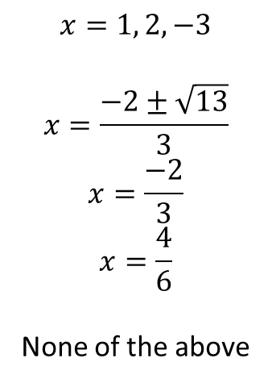
Where are the inflection point(s) for $f\left(x\right)= x^{3}+2x^{2}−3x$?
$$x=1, 2, −3$$
$$x=\frac{−2±\sqrt{13}}{3}$$
$$x=\frac{−2}{3}$$
$$x=\frac{4}{6}$$
None of the above

Slide 6
The function $f\left(x\right)= x^{3}+2x^{2}−3x$ has ____________ asymptotes.
horizontal
vertical
slant
vertical and horizontal
no

