Slide 1
$$\frac{d}{dx} {f(x)}^{3}=$$
3 f(x)²
3 f’(x)² f(x)
0
3 f(x) f’(x)
3 f(x)² f’(x)
None of the above

Slide 2
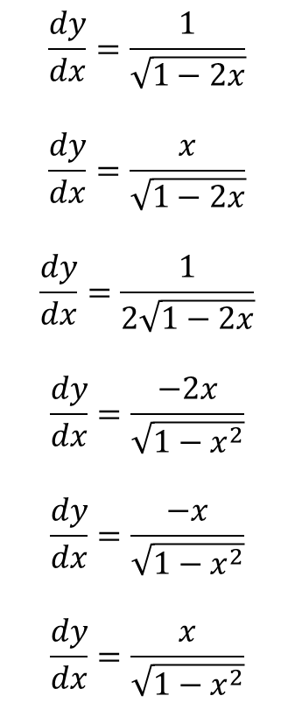
If $y= \sqrt{1−x^{2}}$, then
$$\frac{dy}{dx}=\frac{1}{\sqrt{1−2x}}$$
$$\frac{dy}{dx}=\frac{x}{\sqrt{1−2x}}$$
$$\frac{dy}{dx}=\frac{1}{2\sqrt{1−2x}}$$
$$\frac{dy}{dx}=\frac{−2x}{\sqrt{1−x^{2}}}$$
$$\frac{dy}{dx}=\frac{−x}{\sqrt{1−x^{2}}}$$
$$\frac{dy}{dx}=\frac{x}{\sqrt{1−x^{2}}}$$

Slide 3
If $x^{2}+y^{2}=1$, then $\frac{dy}{dx}=$
2x
-2x
x/y
-x/y
y/x
-y/x
2y
-2y
None of the above

Slide 4
The function $f\left(x\right)=\frac{ (2x+1)(x−3)}{(x−1)(x+2)}$ has a horizontal asymptote of
y=1
y=-1
y=2
y=-2
y=0
y=1/2
y=-1/2
it has no H.A.!

Slide 5
The function $f\left(x\right)=\frac{ (2x+1)(x−3)}{(x−1)(x+2)}$ has roots at
x=1, -2
x = -1, 2
x=1/2, 3
x=-1/2, 3
x=1, -2, -1/2, 3
x=-1, 2, 1/2, -3
x=0
it has no roots!

Slide 6
The function $f\left(x\right)=\frac{ (2x+1)(x−3)}{(x−1)(x+2)}$ has vertical asymptotes at
x=1, -2
x = -1, 2
x=1/2, 3
x=-1/2, 3
x=1, -2, -1/2, 3
x=-1, 2, 1/2, -3
x=0
it has no V.A.!

