Slide 1
When moving with a constant speed in a circular path, velocity is __________
Constant
Equal to speed
Always changing
None of the above.

Slide 2
You and your BFF throw rocks with different initial speeds. The rocks follow parabolic trajectories with the same maximum height. Whose rock hits the ground first if your BFF’s rock hits the ground 10 meters past yours?
Yours
Your BFF’s
They hit at the same time
Not enough info!

Slide 3
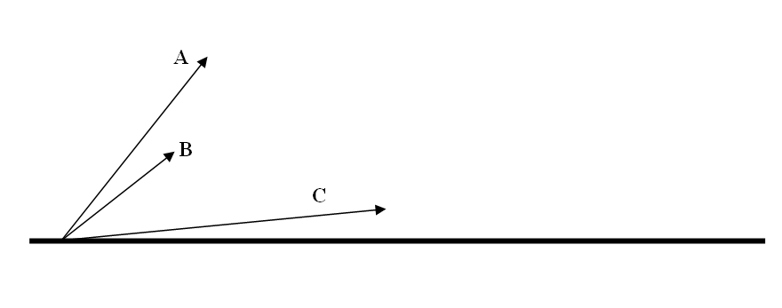
Three projectiles A, B, and C are launched as shown. The arrows represent initial velocities. Which projectile has the greatest initial speed?
A
B
C
Same for all

Slide 4
Three projectiles A, B, and C are launched as shown. The arrows represent initial velocities. Which projectile has the smallest speed immediately before it impacts the ground?
A
B
C
Same for all

Slide 5
Three projectiles A, B, and C are launched as shown. The arrows represent initial velocities. Which projectile has the greatest initial horizontal component of velocity?
A
B
C
Same for all

Slide 6
Three projectiles A, B, and C are launched as shown. The arrows represent initial velocities. Which projectile has the greatest speed at the top point of flight?
A
B
C
Same for all

Slide 7
Three projectiles A, B, and C are launched as shown. The arrows represent initial velocities. Which projectile reaches the greatest height?
A
B
C
Same for all

Slide 8
Three projectiles A, B, and C are launched as shown. The arrows represent initial velocities. Which projectile spends the longest time in the air?
A
B
C
Same for all

Slide 9
Three projectiles A, B, and C are launched as shown. The arrows represent initial velocities. Assuming all projectiles are still in the air after three seconds, which one has the greatest horizontal displacement at that moment?
A
B
C
Same for all

