Slide 1
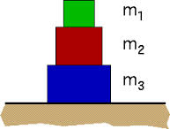
What is the net force on the middle block in the figure to the right if m₁=5 N, m₂=10 N and m₃=15 N.
5 N upward
15 N upward
15 N downward
5 N downward
0 N

Slide 2
Heavier objects experience a greater force due to gravity than lighter objects.
True
False

Slide 3
Heavier objects experience a greater acceleration due to gravity than lighter objects.
True
False

Slide 4
You push a box across a rough floor with a constant speed by applying a constant horizontal force to it. In this scenario…
the net force on the box is in the forward direction
the net force on the box is opposite direction
the net force on the box is zero
the net force depends on the speed

Slide 5
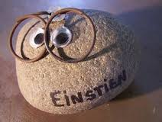
Your pet rock weighs 3.1 N on earth. You take it on a trip to an asteroid with you. On this asteroid, it weighs 0.3 N. What is the acceleration due to gravity on the asteroid (in m/s²)?
Rank | Responses
1
2
3
4
5
6

Slide 6
You apply a constant force of 50.0 N to a block of ice on a smooth, frictionless floor. The block is initially at rest and after 10.0 seconds, you have moved it 35.0 meters. What is the mass of the ice (in kg)?
Rank | Responses
1
2
3
4
5
6

