Slide 1
Suppose that a person is standing on a scale in an elevator when the elevator begins to accelerate upward. According to Newton's Third Law, one of the following forces will be equal and opposite to the force the person exerts on the scale (which is what the scale will read). Choose that force.
The normal force exerted on the person.
The person's mass times their acceleration.
The person's weight.
None of the choices is the appropriate third law pair.
The force exerted on the scale by the elevator.

Slide 2
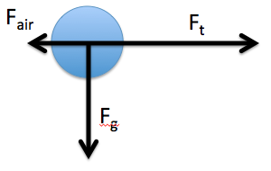
In the diagram to the right, a ball is flying through the air after being thrown. One of the forces drawn on it is inappropriate, inaccurate, or not a real force. Which one is it?
F_{air} , the force of air resistance.
F_{t} , the force of the throw.
F_{g} , the force of gravity.
All of the forces are ok.

Slide 3
Four blocks are placed on a frictionless table. A single horizontal force is applied to each of them. The masses of the blocks and the magnitudes of the applied forces are shown. Which of the blocks has the greatest rate of change in velocity?
Block 1
Block 2
Block 3
Block 4
They are equal

Slide 4
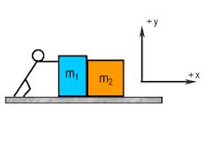
A person pushes two boxes with a horizontal force of 100 N on a frictionless floor. Here, m₁ > m₂. Which of the following is correct?
Blue box pushes on yellow box with 100 N force, and yellow box pushes on blue box with 100 N force.
Blue box pushes on yellow box harder than yellow box pushing on blue box.
The forces of the pushes on each other are equal but less than 100 N.
The boxes will not begin to move unless the total weight of the two boxes is less than 100 N.

Slide 5
A block sits at rest on a frictionless surface. Which of the following sketches most closely resembles the correct freebody diagram for all forces acting on the block? Each red arrow represents a force. Observe their number and direction, but ignore their lengths.
A
B
C
D

Slide 6
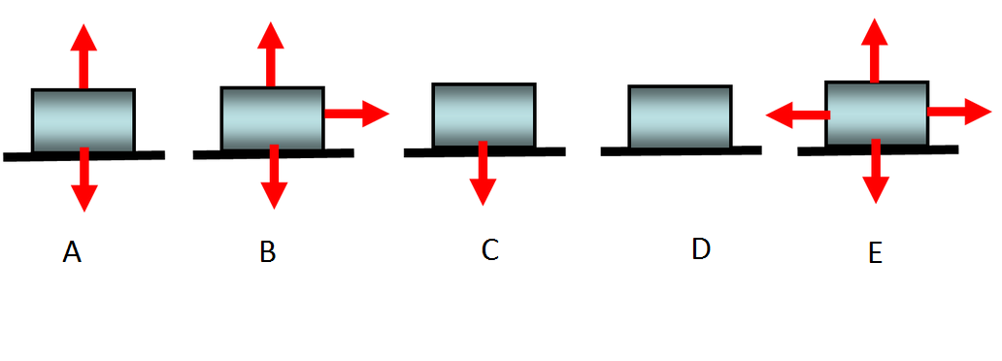
Now, the same block moves with a constant velocity to the right on the frictionless surface. Which of the following most closely resembles the correct freebody diagram for all forces acting on the block?
A
B
C
D
E

Slide 7
Now, the block moves with a constant velocity to the right on a surface that has friction. Which of the following most closely resembles the correct freebody diagram for all forces acting on the block?
A
B
C
D
E

Slide 8
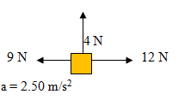
Given the forces acting on the object and the magnitude of its acceleration, find the object's mass (in "kg"). No forces, other than the ones shown, are present.
Rank | Responses
1
2
3
4
5
6

