Slide 1
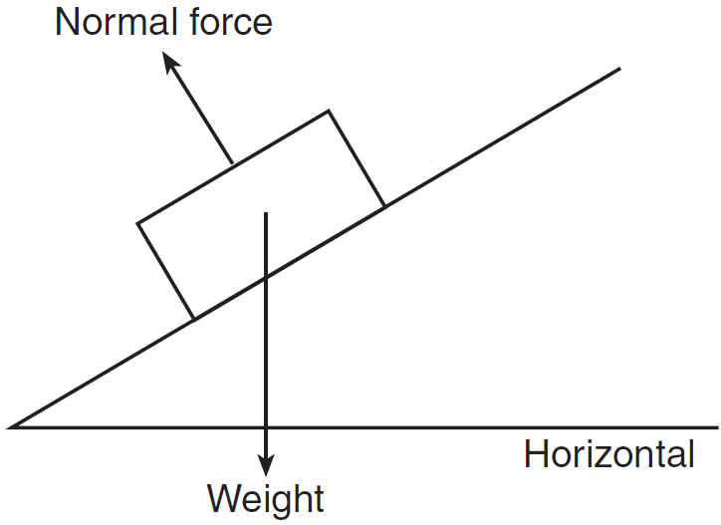
If the block is sliding down the rough ramp at a constant speed,
the force of friction points parallel and up the ramp.
the force of friction points parallel and down the ramp.
there is no friction force since the motion is at a constant speed.
None of the above.

Slide 2
If the block is sliding down the rough ramp at an increasing speed,
the force of friction points parallel and up the ramp.
the force of friction points parallel and down the ramp.
there is no friction force since the motion is at a constant speed.
None of the above.

Slide 3
If the block is sliding up the rough ramp at an increasing speed,
the force of friction points parallel and up the ramp.
the force of friction points parallel and down the ramp.
there is no friction force since the motion is at a constant speed.
None of the above.

Slide 4
If the block is sliding up the rough ramp at an increasing speed,
the force of friction points parallel and up the ramp.
the force of friction points parallel and down the ramp.
there is no friction force since the motion is at a constant speed.
None of the above.

Slide 5
If the block is motionless on the rough ramp, then
the force of friction points parallel and up the ramp.
the force of friction points parallel and down the ramp.
there is no friction force since the motion is at a constant speed.
None of the above.

Slide 6
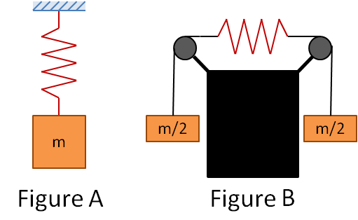
As shown in Figure A, a block of mass m is hanging from a spring attached to the ceiling. As shown in Figure B, two blocks of mass m/2 are hanging from two strings that are attached to a spring that has the same spring constant k. If the spring in Figure A is stretched a distance d, how far will the spring in Figure B stretch?
D
2d
d/2
d/4
4d
None of the above

