Slide 1
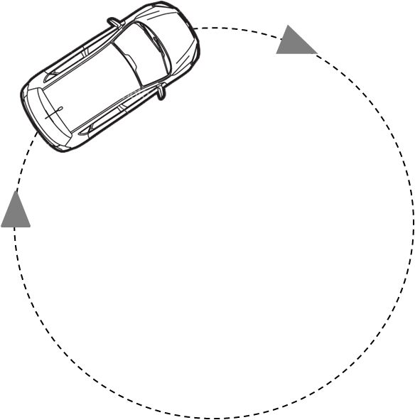
A car rounds a circle while maintaining a constant speed. At the instant shown in the diagram, does the car have an acceleration as it rounds the curve?
No, because its speed is constant.
Yes.
Not enough information is given.

Slide 2
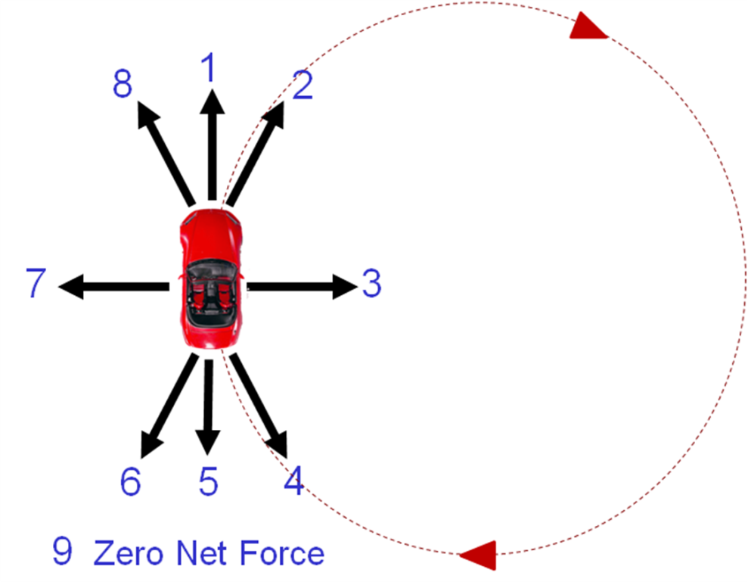
A car rounds a circle while maintaining a constant speed. Which arrow represents the direction of the net force on the car as it rounds the curve at the instant shown above?

Slide 3
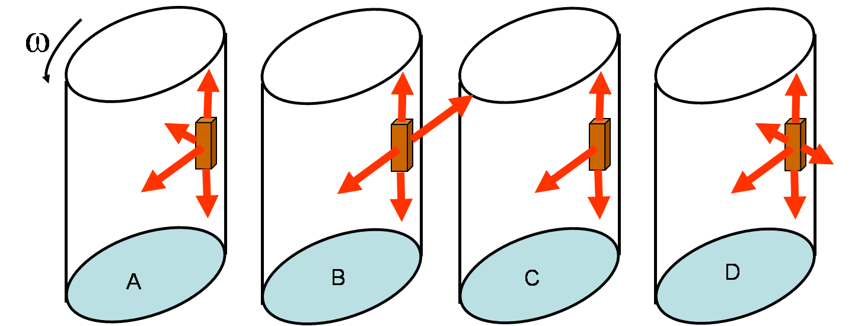
Bob the block is placed next to the cylindrical glass wall of an amusement park ride. The cylinder then spins up to a constant angular velocity, and spinning Bob remains stuck to the wall even when the floor drops away. The free-body diagram of all forces acting on Bob looks like:
None of the above

Slide 4
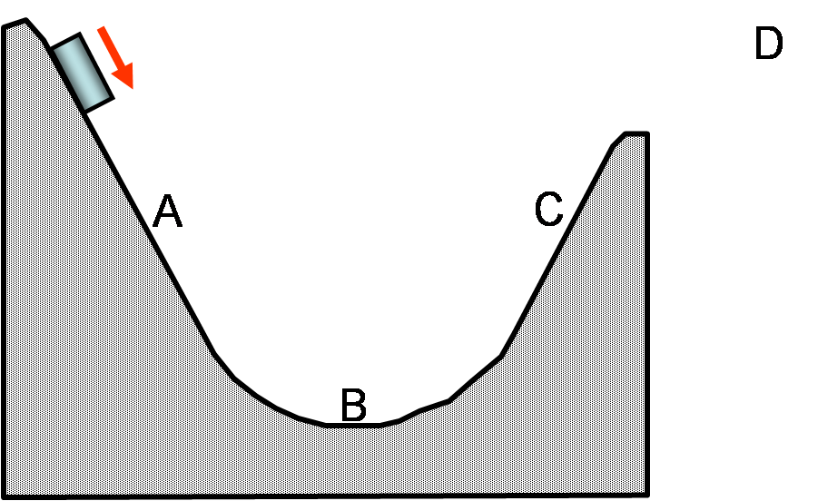
In a physics lab, you place a block on the top of a low-friction ramp. The block slides down the ramp, around a circular part at the bottom, up a ramp on the other side, and then shoots off the end. At what point (if any) is the net force on the block zero?
None of the above

Slide 5
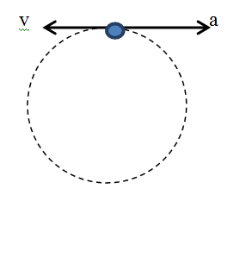
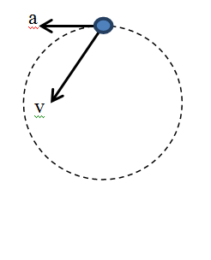
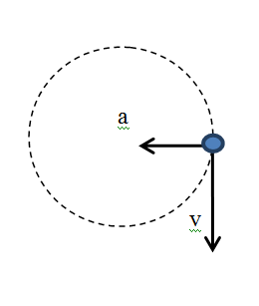
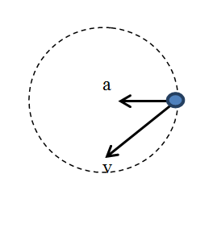
Which of the diagrams shows possible directions of tangential velocity (v) and acceleration (a) vectors for an object moving at a constant speed in a circular trajectory?

Slide 6
An object of mass 10 kg is moving at a constant speed in a circle of radius 12 m. The period of revolution (the time it takes to complete one revolution) is 45 s. Find the tangential speed of the object (in m/s).
Rank | Responses
1
2
3
4
5
6

Slide 7
An object of mass 10 kg is moving at a constant speed in a circle of radius 12 m. The period of revolution is 45 s. Find the acceleration of the object (in m/s²).
Rank | Responses
1
2
3
4
5
6

Slide 8
An object of mass 10 kg is moving at a constant speed in a circle of radius 12 m. The period of revolution is 45 s. Find the net force acting on the object.
Rank | Responses
1
2
3
4
5
6

