Slide 1
If $v(t)$ has units meters per second, then $\int{v\left(t\right)dt}$ has units…..
meters per second²
seconds
seconds²
meters² per second
meters
meters² per second²

Slide 2
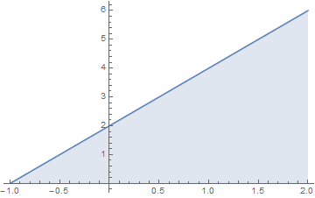
Calculate $\int_{−1}^{2}{f\left(x\right)dx}$, where $f(x)$ is given in the figure to the right.
Rank | Responses
1
2
3
4
5
6 | Other

Slide 3
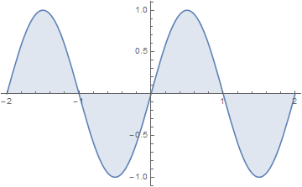
Calculate $\int_{−2}^{2}{f\left(x\right)dx}$, where $f(x)$ is given in the figure to the right.
Rank | Responses
1
2
3
4
5
6 | Other

Slide 4
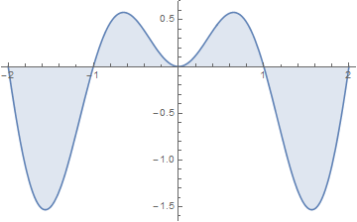
$\int_{−2}^{2}{f\left(x\right)dx}$, where $f(x)$ is given in the figure to the right, is
Positive
Negative
Zero
Not enough info.

