Slide 1
$\int_{a}^{b}{f\left(t\right)dt}$ is
An antiderivative of f(t)
An area under f(t)
An average value of f(t)
Both A and B
Both A and C
None of the above

Slide 2
$\frac{1}{b−a}\int_{a}^{b}{f\left(t\right)dt}$ is
An antiderivative of f(t)
An area under f(t)
An average value of f(t)
Both A and B
Both A and C
None of the above

Slide 3
The derivative of a function can not be computed at a point if the function is not continuous at that point.
True
False

Slide 4
Definite integrals can only be computed if the function is continuous.
True
False

Slide 5
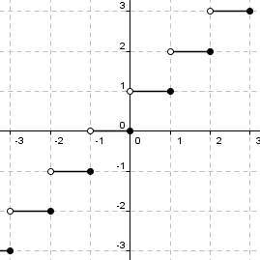
If f(t) is given by the graph to the right, compute $\int_{0}^{3}{f\left(t\right)dt}$
Rank | Responses
1
2
3
4
5
6

Slide 6
If f(t) is given by the graph to the right, compute $\int_{3}^{0}{f\left(t\right)dt}$
Rank | Responses
1
2
3
4
5
6

Slide 7
If f(t) is given by the graph to the right, compute $\int_{−3}^{1}{f\left(t\right)dt}$
Rank | Responses
1
2
3
4
5
6

