Slide 1
Suppose you are on a cart initially at rest that rides on a frictionless track. If you throw a ball off the cart towards the left, will the cart be put into motion?
Yes, to the right.
Yes, to the left.
No, it will remain in place.

Slide 2
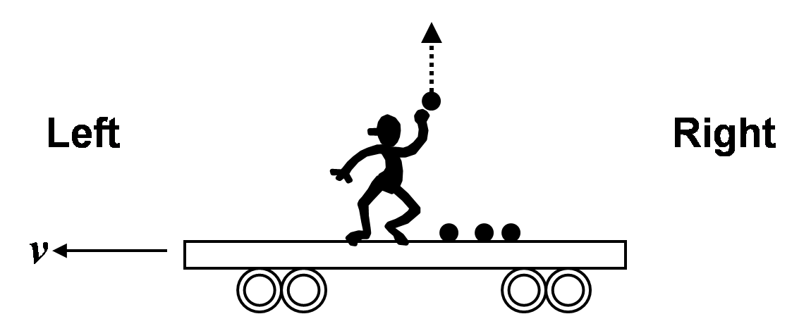
Suppose you are on a cart that is moving at a constant speed v to the left on a frictionless track. If you throw a massive ball straight up (from your perspective), how will the speed of the cart change?
The speed of the cart will increase.
The speed of the cart will decrease.
The speed of the cart will not change.
You need to know how fast the ball was thrown.

Slide 3
What is the total momentum of the system that includes spheres 1 and 2 only?
5 kg m/s to the left
12 kg m/s to the right
16 kg m/s to the left
28 kg m/s to the right
30 kg m/s to the right
4 kg m/s to the left
None of the above

Slide 4
What is the total momentum of the system that includes spheres 2 and 3 only?
12 kg m/s to the left
12 kg m/s to the right
9 kg m/s to the left
9 kg m/s to the right
3 kg m/s to the right
21 kg m/s to the right
None of the above

Slide 5
What is the total momentum of the system that includes all 3 spheres?
13 kg m/s to the left
13 kg m/s to the right
19 kg m/s to the left
19 kg m/s to the right
5 kg m/s to the right
5 kg m/s to the left
None of the above

Slide 6
What is the magnitude of the total momentum of the system that includes spheres 1 and 2 only?
28 kg m/s
66 kg m/s
4.0 kg m/s
8.5 kg m/s
20 kg m/s
None of the above

Slide 7
What is the magnitude of the total momentum of the system that includes all three spheres?
About 37 kg m/s
About 19 kg m/s
About 31 kg m/s
About 26 kg m/s
About 16 kg m/s
None of the above

