Slide 1
S = rθ is valid for θ in both degrees and radians.
True
False

Slide 2
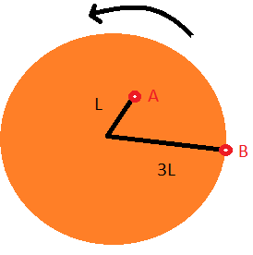
Two points are on a disk that rotates about an axis perpendicular to the plane of the disk at its center. Point B is 3 times as far from the axis as point A. If the linear speed of point B is V, then the linear speed of point A is
9V
3V
V
V/3
V/9
None of the above

Slide 3
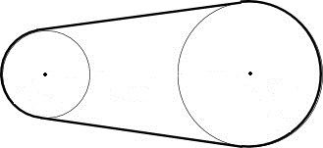
Two wheels are connected by a chain. If v₁ and ω₁ are linear and angular velocities of the smaller wheel, and v₂ and ω₂ are linear and angular velocities of the larger wheel, which of the following is true:
v₁ = v₂ and ω₁ > ω₂
v₁ = v₂ and ω₁ < ω₂
v₁ = v₂ and ω₁ = ω₂
ω₁ = ω₂ and v₁ > v₂
ω₁ = ω₂ and v₁ < v₂
ω₁ = ω₂ and v₁ = v₂
v₁ = v₂ and ω₁ = ω ₂
none of the above

Slide 4
If a wheel 212 cm in diameter takes 2.25 s for each revolution, what is its period?
Rank | Responses
1
2
3
4
5
6

Slide 5
If a wheel 212 cm in diameter takes 2.25 s for each revolution, what is its angular speed?
Rank | Responses
1
2
3
4
5
6

Slide 6
When the power is turned off on a turntable spinning at 78.0 rpm, you find that it takes 10.5 revolutions for it to stop while slowing down at a uniform rate. What is the angular acceleration (rad/s²) of this turntable?
Rank | Responses
1
2
3
4
5
6

Slide 7
When the power is turned off on a turntable spinning at 78.0 rpm, you find that it takes 10.5 revolutions for it to stop while slowing down at a uniform rate. How long does it take to stop after the power is turned off? Here, you may assume α = -0.506 rad/s².
Rank | Responses
1
2
3
4
5
6

