Slide 1
A thin uniform bar has a moment of inertia I about an axis perpendicular to it through its center. If both the mass and length of this bar were doubled, its moment of inertial about the same axis will be
2I
4I
8I
16I

Slide 2
A uniform ball rolls without slipping toward a hill with a forward speed V. In which case will this ball go further up the hill?
There is enough friction on the hill to prevent slipping of the ball.
The hill is frictionless.
Conservation of energy implies the ball will roll to the same height for both of the above cases.

Slide 3
Four uniform objects have the same mass and diameter are released from rest at the same distance from the bottom of a hill and roll down without slipping. The objects are a solid sphere, solid cylinder, hollow cylinder, and a thin-walled hollow cylinder. Which object will be the first to reach the bottom of the hill?
Solid sphere
Solid cylinder
Hollow cylinder
Thin-walled hollow cylinder
They all arrive at the same time!

Slide 4
Four uniform objects have the same mass and diameter are released from rest at the same distance from the bottom of a hill and roll down without slipping. The objects are a solid sphere, solid cylinder, hollow cylinder, and a thin-walled hollow cylinder. Determine which of the following statements are correct:
All the objects have the same forward speed at the bottom of the hill.
All the objects have the same kinetic energy at the bottom of the hill.
All the objects have the same rotational kinetic energy at the bottom of the hill.
All the objects have the same angular velocity at the bottom of the hill.

Slide 5
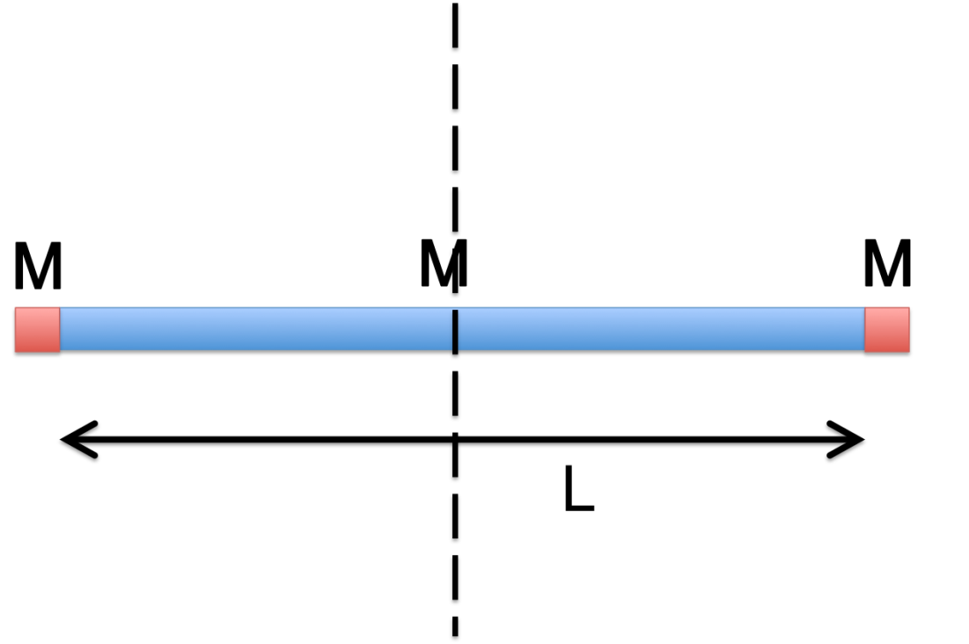
Two point like objects of mass M each are attached to a thin rod of mass M and Length L. The rod and the masses are spinning at a constant rate ω about an axis perpendicular to that of the rod. What is the kinetic energy of the composite object (rod + 2 point objects)?
ML²ω²/12
7ML²ω²/12
7ML²ω²/24
ML²ω²/24
5ML²ω²/12
7ML²ω²/6
ML²ω²/3
ML²ω²/4

