Slide 1
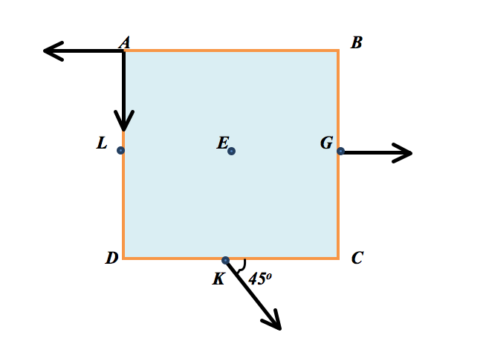
Find the magnitude of the torque acting on the plate of side length d with respect to the axis passing through point A perpendicular to the page due to the force F located at point G.
0
Fd/2
Fd
2Fd
4Fd
Fd²

Slide 2
Find the magnitude of the torque acting on the plate of side length d with respect to the axis passing through point A perpendicular to the page due to the two forces of magnitude F each located at point A.
0
Fd/2
Fd
2Fd
4Fd
Fd²

Slide 3
Find the magnitude of the torque acting on the plate of side length d with respect to the axis passing through point A perpendicular to the page due to the force F located at point K.
0
Fd
Fd/$\sqrt{2}$
Fd/2
Fd/(2$\sqrt{2}$)
$\sqrt{2}$Fd

Slide 4
Find the magnitude of the torque acting on the plate of side length d with respect to the axis passing through point E perpendicular to the page due to the forces each of magnitude F located at point A.
0
Fd
Fd/$\sqrt{2}$
Fd/2
Fd/(2$\sqrt{2}$)
$\sqrt{2}$Fd

Slide 5
Find the magnitude of the torque acting on the plate of side length d with respect to the axis passing through point E perpendicular to the page due to all of the forces depicted.
0
Fd
Fd+Fd/$\sqrt{2}$
Fd+Fd/2
Fd+Fd/(2$\sqrt{2}$)
Fd+$\sqrt{2}$Fd

Slide 6
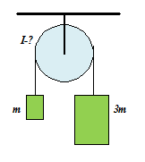
If we assume the pulley in the figure has mass, then when the system is set into motion, the tensions in the rope on the left and right sides of the pulley are equal.
True
False
It depends on the acceleration

Slide 7
When the system, shown in the diagram, is released from rest, the magnitude of the acceleration of each block is g/3. The masses of the blocks are m and 3m, the radius of the pulley is r. There is no slipping between the pulley and the light string that connects the blocks. Find the moment of inertia of the pulley.
I = 2*mr²
I = 3/2*mr²
I = 1/2*mr²
I = 5/2*mr²
I = mr²
I = 3mr²

