Slide 1
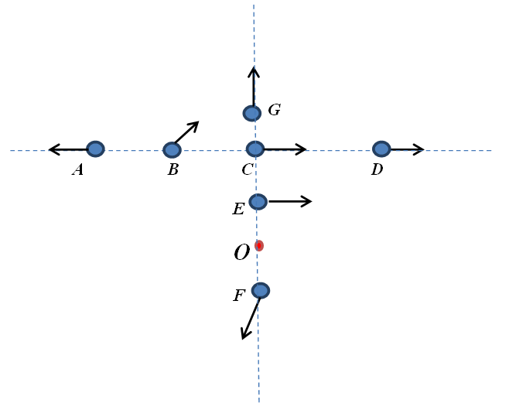
Rank the magnitudes of angular momenta of particles labeled A-G relative to the axis passing through point O. All particles have equal masses and speeds
L_{B}>L_{A}=L_{F}=L_{G}>L_{E}>L_{C}>L_{D}
L_{C}=L_{B}=L_{A}=L_{D}>L_{E}=L_{F}>L_{G}
L_{A}>L_{B}=L_{C}=L_{D}>L_{E}>L_{F}>L_{G}
L_{B}>L_{A}=L_{C}=L_{D}>L_{E}>L_{F}>L_{G}
L_{B}>L_{G}=L_{C}=L_{D}>L_{F}>L_{E}>L_{A}

Slide 2
A light rigid rod of length 3s where s = 1.2 m has small spheres of masses m = 0.15 kg, 2m, 3m and 4m attached as shown. The rod is spinning in a horizontal plane with angular speed ω = 0.8 rad/s about a vertical axis. Find the magnitude of angular momentum of the rod where the axis of rotation is passing through mass m at point A.
Rank | Responses
1
2
3
4
5
6

Slide 3
A light rigid rod of length 3s where s = 1.2 m has small spheres of masses m = 0.15 kg, 2m, 3m and 4m attached as shown. The rod is spinning in a horizontal plane with angular speed ω = 0.8 rad/s about a vertical axis. Find the magnitude of angular momentum of the rod where the axis of rotation is passing through mass m at point B.
Rank | Responses
1
2
3
4
5
6

Slide 4
A light rigid rod of length 3s where s = 1.2 m has small spheres of masses m = 0.15 kg, 2m, 3m and 4m attached as shown. The rod is spinning in a horizontal plane with angular speed ω = 0.8 rad/s about a vertical axis. Find the magnitude of angular momentum of the rod where the axis of rotation is passing through mass m at point C.
Rank | Responses
1
2
3
4
5
6

Slide 5
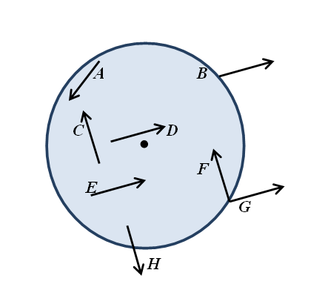
A disc is spinning clockwise (as viewed from above) about the axis passing through the center of the disc. Force F can be applied to it in several different ways, as shown in the diagram. (Note that the tail of each vector shows the point of application of the force.) Which of those ways would result in an increase of the magnitude of the angular momentum of the disc?
B, C, D
B, D, E, G
A, F, G, H
B, D, F
A, E, F

Slide 6
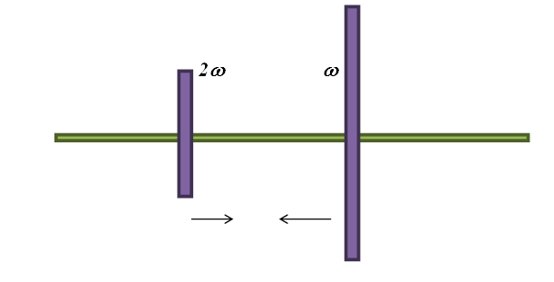
The diagram shows the side view of two uniform solid discs spinning in the same direction on a horizontal thin frictionless axle. The discs are made of the same material that has the same thickness. The disc on the right has twice the radius of the disc on the left. The angular speeds of the discs are 2ω and ω, respectively. The discs are slowly brought in contact with each other. Due to the friction between the surfaces, the discs eventually begin to spin with the same angular speed. If the rotational inertia of the smaller disc about the axis of rotation is I, then the rotational inertia of the larger disc about its axis of rotation is:
2I
4I
8I
16I
32I

Slide 7
The diagram shows the side view of two uniform solid discs spinning in the same direction on a horizontal thin frictionless axle. The discs are made of the same material that has the same thickness. The disc on the right has twice the radius of the disc on the left. The angular speeds of the discs are 2ω and ω, respectively. The discs are slowly brought in contact with each other. Due to the friction between the surfaces, the discs eventually begin to spin with the same angular speed. The magnitude of the final angular speed of the discs is:
18ω/17
20ω/17
6ω/5
8ω/5
10ω/9

