Slide 1
Consider an idealized pendulum consisting of a point mass of mass m hanging from a light (massless) string of length L. The pendulum undergoes small oscillations, and can be considered to be undergoing simple harmonic motion. If the mass of the point mass is changed to 4m, the frequency will:
Increase by a factor of 4
Increase by a factor of 2
Decrease by a factor of 4
Decrease by a factor of 2
None of the above

Slide 2
Consider an idealized pendulum consisting of a point mass of mass m hanging from a light (massless) string of length L. The pendulum undergoes small oscillations, and can be considered to be undergoing simple harmonic motion. If the string length is changed to 4L, the frequency will:
Increase by a factor of 4
Increase by a factor of 2
Decrease by a factor of 4
Decrease by a factor of 2
None of the above

Slide 3
Consider an idealized pendulum consisting of a point mass of mass m hanging from a light (massless) string of length L. The pendulum undergoes small oscillations, and can be considered to be undergoing simple harmonic motion. If the initial amplitude doubles, the frequency will:
Double
Quadruple
Not change
Increase by a factor of 2
None of the above

Slide 4
A visitor to the GDJ Student Union wishes to determine the height of the union. She ties a spool of thread to a small rock to make a simple pendulum, which she hangs down from the roof of the union. The period of oscillation is 7.85 seconds. What is the height of the union in meters, assuming that the rock just misses the ground and the other end is tied near the top of the tower?
Rank | Responses
1
2
3
4
5
6

Slide 5
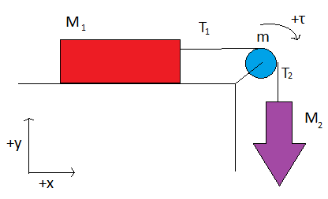
A weight of mass M₁ sitting on a rough surfaced table is attached to a mass M₂ hanging off the table via a pulley with mass m. The system is set in motion and mass M₂ drops. Using the orientation for +x and +y given, which of the following is NOT a correct equation for block M₁.
T₁-F_{k} = M₁a
T₁-μ_{k}M₁g = M₁a
n-M₁g = 0
T₁-μ_{k}M₁g = 0
n-M₁g = M₁a
Both D and E are incorrect

Slide 6
A weight of mass M₁ sitting on a rough surfaced table is attached to a mass M₂ hanging off the table via a pulley with mass m. The system is set in motion and mass M₂ drops. Using the orientation for +x and +y given, which of the following is a correct equation for block M₂.
T₂-F_{k} = -M₂a
T₂-M₂g = -M₂a
T₂-F_{k} = M₂a
T₂-M₂g = M₂a
Both A and B are correct

Slide 7
A weight of mass M₁ sitting on a rough surfaced table is attached to a mass M₂ hanging off the table via a pulley with mass m. The system is set in motion and mass M₂ drops. Using the orientation for +x and +y given, which of the following is NOT a correct equation for the pulley of mass m.
τ₁- τ₂ = Iα
τ₂- τ₁ = Iα
τ₂- τ₁ = Ia/r
rT₂- rT₁ = Ia/r

