Slide 1
Two pulses of exactly the same size and shape are traveling toward each other along a stretched rope. They differ only in that one is upright while the other is inverted. How will the rope appear at the instant they are superimposed?
There will be a double wave at the point of superposition.
They will not interact.
There will appear to be no wave at all.
This situation cannot occur!

Slide 2
Two pulses of exactly the same size and shape are traveling toward each other along a stretched rope. They differ only in that one is upright while the other is inverted. How will the rope appear after they have interacted?
Each pulse continues as though they never interacted.
Each pulse stops and travels back the direction it came from.
There waves have canceled each other out, so the rope is straight again.
The pulses invert and continue traveling in the direction they were originally traveling in.

Slide 3
Two pulses of exactly the same size and shape are traveling toward each other along a stretched rope. How will the rope appear at the instant they are superimposed?
There will be single wave of twice the height of the single waves.
They will not interact.
There will appear to be no wave at all.
This situation cannot occur!

Slide 4
On a string of length L fixed at both ends, it is possible to have a standing wave with wavelength greater than L.
Well yes, of course it is possible.
False, this is crazy!
It’s a trap!

Slide 5
On a string of length L fixed at both ends, it is possible to have a standing wave with any wavelength less than 2L.
Well yes, of course it is possible.
False, obviously.
It’s a trap (again)!

Slide 6
On a string of length L fixed at both ends, it is possible to have a standing wave with any fundamental frequency (within reason).
Well yes, of course it is possible.
False, obviously.
It’s a trap (again)!

Slide 7
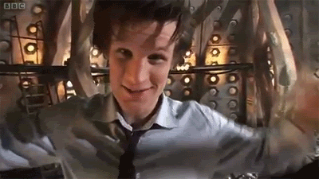
For a musical instrument which uses longitudinal standing waves in vibrating air columns to produce tones, having the end open makes the end a:
Node
Antinode
It depends

