Slide 1
You notice two of your professors talking casually when you overhear your name. Unfortunately, you can only hear the sound in faint whispers of about 20dB. You are 30 meters away, how much closer (in meters) do you need to be to hear the conversation at 65 dB?
Rank | Responses
1
2
3
4
5
6

Slide 2
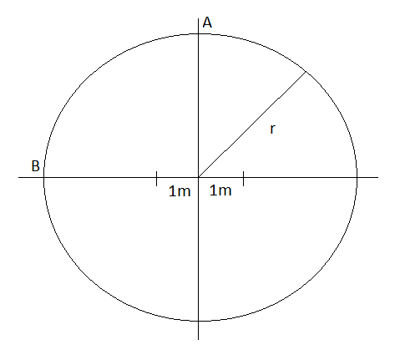
You are located at point A. Your nemesis is located at point B. Your friends are trying to signal you. They are both located 1 meter from the center of a circle of radius r as shown. If they signal you with pure sinusoidal waves, what must the first frequency be so that your nemesis does not hear the signal? (v = 350 m/s in air)
Rank | Responses
1
2
3
4
5
6

Slide 3
The intensity due to a number of independent sound sources is the sum of individual intensities.
True
False

Slide 4
You are located at point A. Your nemesis is located at point B. Your friends are trying to signal you. They are both located 1 meter from the center of a circle of radius r as shown. You can discern sounds as quiet as 10dB. Your friends can only transmit at max intensity of 25dB each. How large can the radius of the circle be?
Rank | Responses
1
2
3
4
5
6

