Slide 1
Two parallel plate capacitors of different capacitance will have the same charge on their plates if they are connected in _______.
series
parallel
either serial or parallel
(it can’t happen!)

Slide 2
When induced, electric fields in a conductor travel with a speed approaching that of light.
True
False

Slide 3
In the presence of an electric field on a conducting wire, electrons are accelerated to close to the speed of light along the conducting wire’s surface.
True
False

Slide 4
The equivalent resistance of any number of resistors in _____ equals the sum of their individual resistances.
series
parallel
both series and parallel
neither series nor parallel

Slide 5
For any number of resistors in parallel, the equivalent resistance is always less than any individual resistance.
True
False

Slide 6
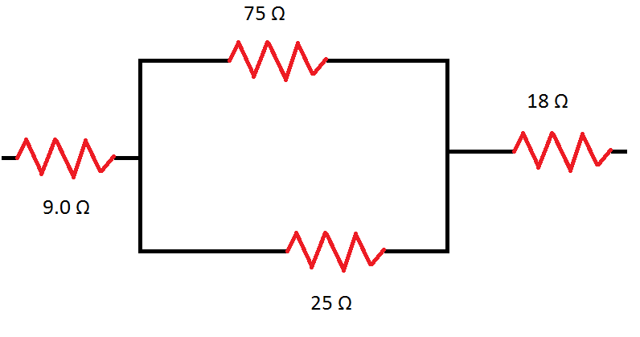
Find the equivalent resistance of the combination depicted in the figure to the right.
Rank | Responses
1
2
3
4
5
6

Slide 7
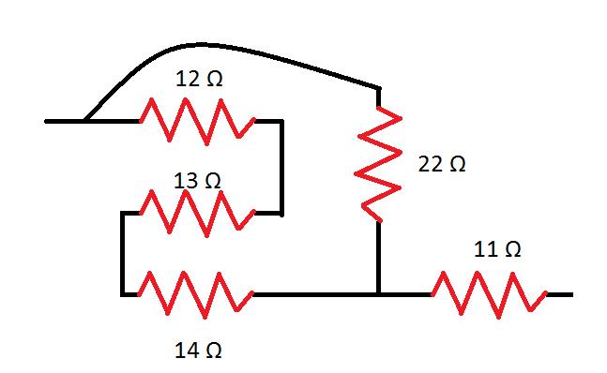
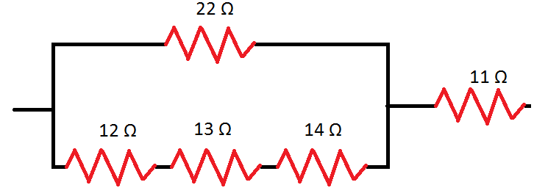
The two sequences of resistors depicted above are equivalent.
True
False

Slide 8
Find the equivalent resistance for the combination depicted above
Rank | Responses
1
2
3
4
5
6

Slide 9
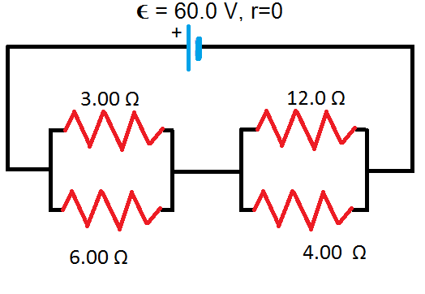
Compute the equivalent resistance (in Ω) in the network in the figure to the right.
Rank | Responses
1
2
3
4
5
6

Slide 10
Compute the net current (in A) in the network in the figure to the right.
Rank | Responses
1
2
3
4
5
6

Slide 11
Compute the potential difference (in V) across the 12 Ω and 4 Ω resistors.
Rank | Responses
1
2
3
4
5
6

Slide 12
Compute the current through the 12.0 Ω resistor.
Rank | Responses
1
2
3
4
5
6

