Slide 1
If you take a magnet and cut it in three sections between the north and south pole, then
you have three magnets with N/S poles.
you have two magnets with N/S poles and one that is no longer a magnet.
one magnet has a N pole only, another has a S pole only, and the middle is no longer a magnet.
none of the above occur.

Slide 2
Magnetic effects can be produced by an electric current.
True
False

Slide 3
Magnetic fields exert force on moving charges.
True
False

Slide 4
Magnetic fields exert force on stationary charges.
True
False

Slide 5
The SI unit for the magnitude of a magnetic field B is the ________
Rank | Responses
1
2
3
4
5
6

Slide 6
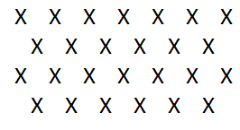
For the magnetic field depicted to the right, the magnetic field points
to the left
to the right
towards the top of the screen
towards the bottom of the screen
into the screen
out of the screen

Slide 7
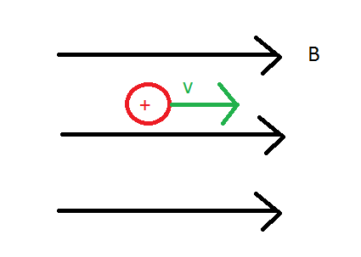
The force the magnetic field exerts on the positively charged particle points in the direction:
to the left
to the right
towards the top of the screen
towards the bottom of the screen
into the screen
out of the screen
none of the above

Slide 8
The force exerted on a moving charged particle by a magnetic field is perpendicular to
the direction of motion.
the magnetic field.
both the direction of motion and the magnetic field.
neither the field nor the direction of motion.

Slide 9
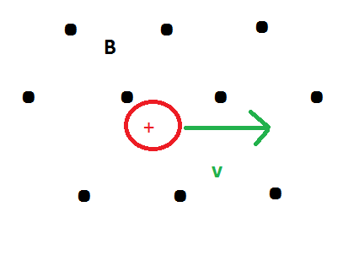
In what direction does the resulting force point?
to the left
to the right
towards the top of the screen
towards the bottom of the screen
into the screen
out of the screen
none of the above

Slide 10
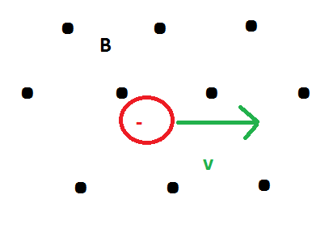
In what direction does the resulting force point?
to the left
to the right
towards the top of the screen
towards the bottom of the screen
into the screen
out of the screen
none of the above

Slide 11
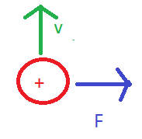
In what direction does the magnetic field point?
to the left
to the right
towards the top of the screen
towards the bottom of the screen
into the screen
out of the screen
none of the above

Slide 12
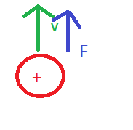
The scenario to the right is possible…
True
False

Slide 13
A particle of mass 5.00 x 10⁻³ kg and a charge of 3.5 x 10⁻⁸ C has a velocity with magnitude 2.00 x 10⁵ m/s in the +y direction. It is moving in a uniform magnetic field of magnitude 0.8 T and is in the –x direction. Calculate the magnitude of the force exerted on the particle by the magnetic field (in N).
Rank | Responses
1
2
3
4
5
6

Slide 14
A particle of mass 5.00 x 10⁻³ kg and a charge of 3.5 x 10⁻⁸ C has a velocity with magnitude 2.00 x 10⁵ m/s in the +y direction. It is moving in a uniform magnetic field of magnitude 0.8 T and is in the –x direction. What is the direction of the magnetic force on the charged particle?
+x
-x
+y
-y
+z
-z

