Slide 1
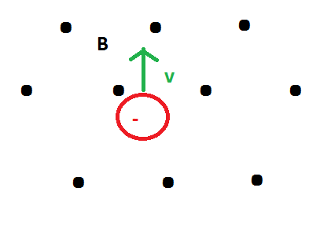
In what direction does the resulting force point?
to the left
to the right
towards the top of the screen
towards the bottom of the screen
into the screen
out of the screen
none of the above

Slide 2
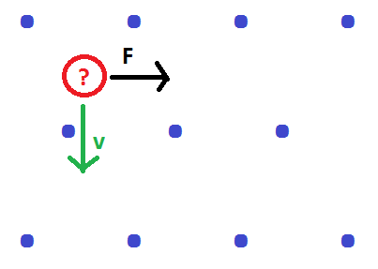
What must the sign of the charged particle be to satisfy the resulting force due to the magnetic field?
Positive
Negative
Its not possible!

Slide 3
If the negatively charged particle has a constant velocity, then in a constant strength magnetic field, the particle will always undergo circular motion.
True
False

Slide 4
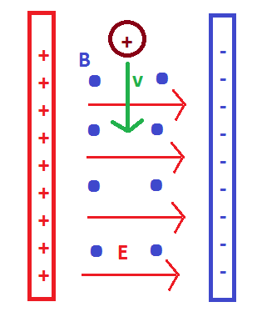
In what direction does the force due to the electric field on the charged particle point?
to the left
to the right
towards the top of the screen
towards the bottom of the screen
into the screen
out of the screen
none of the above

Slide 5
In what direction does the force due to the magnetic field on the charged particle point?
to the left
to the right
towards the top of the screen
towards the bottom of the screen
into the screen
out of the screen
none of the above

Slide 6
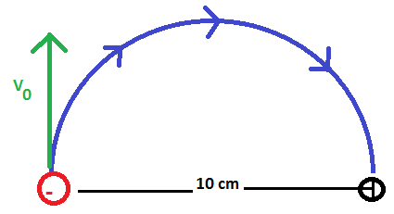
An electron follows the semicircular path as depicted to the right. In what direction must the magnetic field point for the electron to travel in the path depicted?
to the left
to the right
towards the top of the screen
towards the bottom of the screen
into the screen
out of the screen
none of the above

Slide 7
An electron follows the semicircular path as depicted to the right. In what direction must the magnetic field point for the electron to travel in the path depicted?
to the left
to the right
towards the top of the screen
towards the bottom of the screen
into the screen
out of the screen
none of the above

Slide 8
If the initial velocity of the electron is 1.41 x 10⁶ m/s, what must the magnitude of the magnetic field be to follow the semicircular path? (Express your answer in mT.)
Rank | Responses
1
2
3
4
5
6

Slide 9
If the initial velocity of the electron is 1.41 x 10⁶ m/s, how long does it take the particle to travel the semicircular path? (Express your answer in μS.)
Rank | Responses
1
2
3
4
5
6

Slide 10
If the electron is replaced with a proton, in what direction must the magnetic field point?
to the left
to the right
towards the top of the screen
towards the bottom of the screen
into the screen
out of the screen
none of the above

Slide 11
Since the charge of a proton and electron are the same, does the strength of the magnetic field stay the same to produce the two paths to the right?
Yes
No

