Slide 1
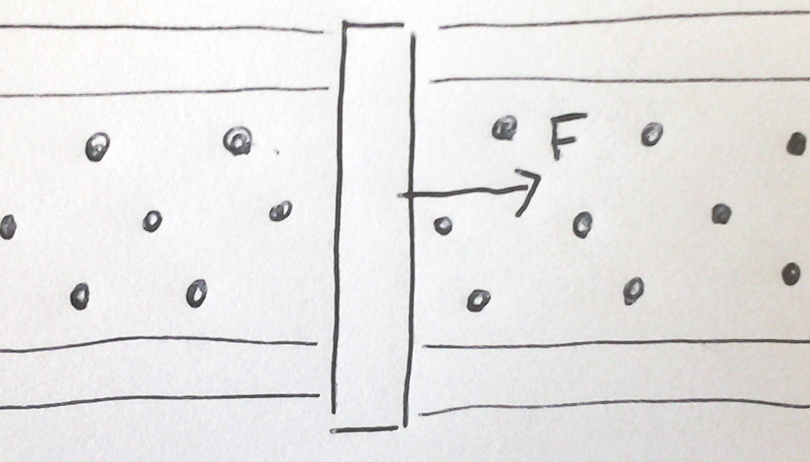
What direction must the current be flowing though the bar if it is accelerating to the right.
Up
Down

Slide 2
The normal line to a loop or collection of loops is the line _______ to the loops.
Parallel
Perpendicular

Slide 3
The angle φ is the angle measured between _________.
Plane of the magnetic field and the plane of the loop.
Plane of the magnetic field and the normal to the loop.
The direction of the magnetic field and the normal to the loop.

Slide 4
To maximize τ, the angle φ between the magnetic field and the normal to the loop should be (in degrees)
Rank | Responses
1
2
3
4
5
6

Slide 5
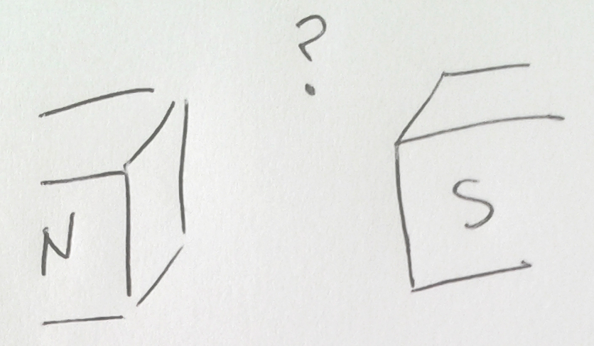
In what direction does the magnetic field point given in the figure on the right?
Left to right (N to S)
Right to left (S to N)

Slide 6
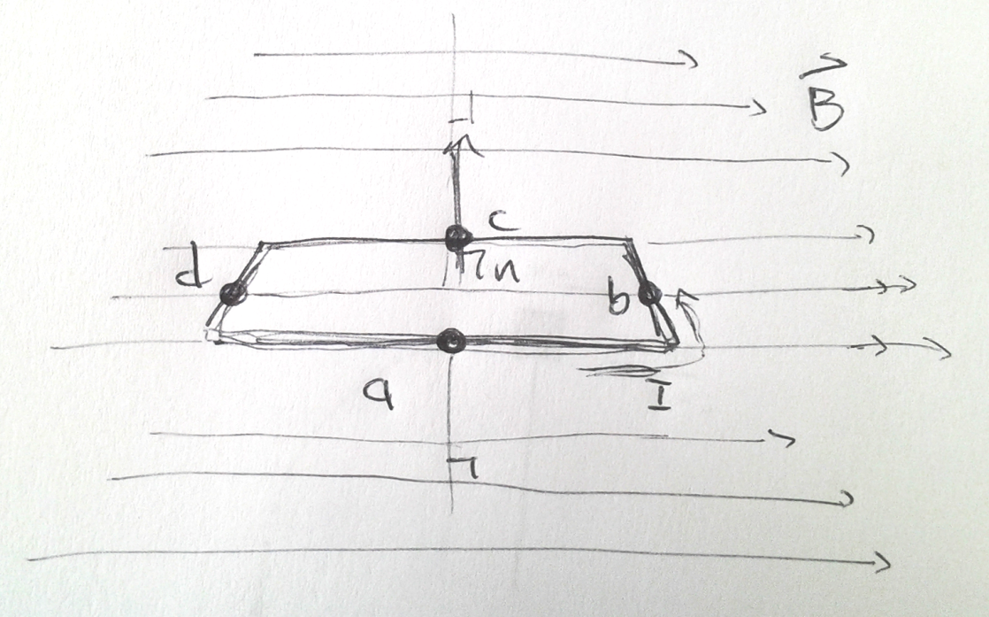
At which points (a,b,c,d) will there be no torque on the loop due to the magnetic field.
A
B
C
D
A and C
D and B
A, B, C, and D

Slide 7
At point b, where will the force due to the magnetic field point?
Up
Down
left
Right
Out of the page
Into the page

Slide 8
At point d, where will the force due to the magnetic field point?
Up
Down
left
Right
Out of the page
Into the page

Slide 9
Will this loop end up rotating in the magnetic field?
Yes
No

Slide 10
Through which line will the loop rotate?
Line through ac
Line through db

Slide 11
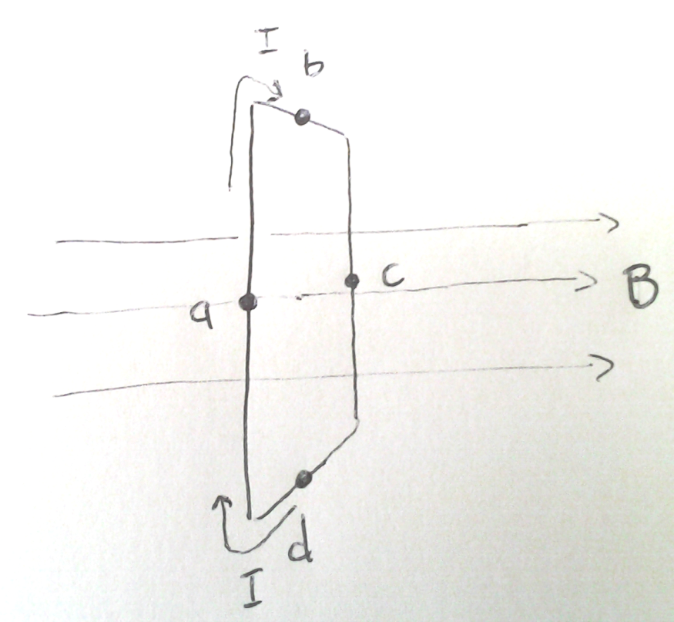
At which of the points (a,b,c,d) will there be NO force due to the magnetic field?
A
B
C
D
A and C
B and D
All the points
None of the points

