Slide 1
Energy in a capacitor is stored
On the outside of the plates
In the plates
On the inside of the plates
In the electric field between the plates

Slide 2
Energy in an inductor is stored
On the surface of the inductor coils
In the magnetic field induced by the coils
No energy is stored in an inductor!

Slide 3
To induce an emf in an inductor, the current through the inductor must be
Zero
Non-constant zero
changing

Slide 4
If the current through an inductor is increasing, then the emf points
in the direction of current.
opposite the direction of current.
perpendicular to the current.
none of the above

Slide 5
According to Lenz’s law, the direction of any magnetically induced current or emf is such as to ________ the direction of the phenomenon causing it.
oppose
reinforce

Slide 6
For a toroidal solenoid, the amount of energy stored in the magnetic field depends upon
the number of coils
cross sectional area
strength of resulting magnetic field
all of the above
none of the above

Slide 7
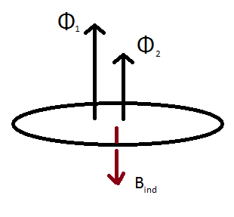
In order to create the induced magnetic field (red) given, the flux must change from
Φ₁ to Φ₂
Φ₂ to Φ₁
Neither will induce the magnetic field depicted.

Slide 8
Looking at the ring from above, induced current will flow
clockwise
counter-clockwise
there will be no induced current.

Slide 9
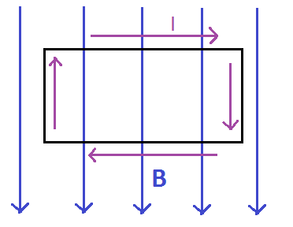
What direction does the force due to the magnetic field on the upper section of the closed loop point?
left
right
up
down
into the board
out of the board
nowhere

